Slide 1
Narration
The course you are about to complete contains narration
  If you can hear the narration, click > Go to Next Page for an introduction to navigating the course player
  If you are familiar with navigating the course player, click > Begin Course to skip the course player navigation instructions
  If you cannot hear the narration, please turn on your speakers or connect your headphones, then click > Repeat Narration
Notes:
The course you are about to complete contains narration. If you can hear the narration, click the blue underlined text “Go to Next Page”. If you are familiar with navigating the course player and want to begin the course, click the blue underlined text “Begin Course”.

Slide 2
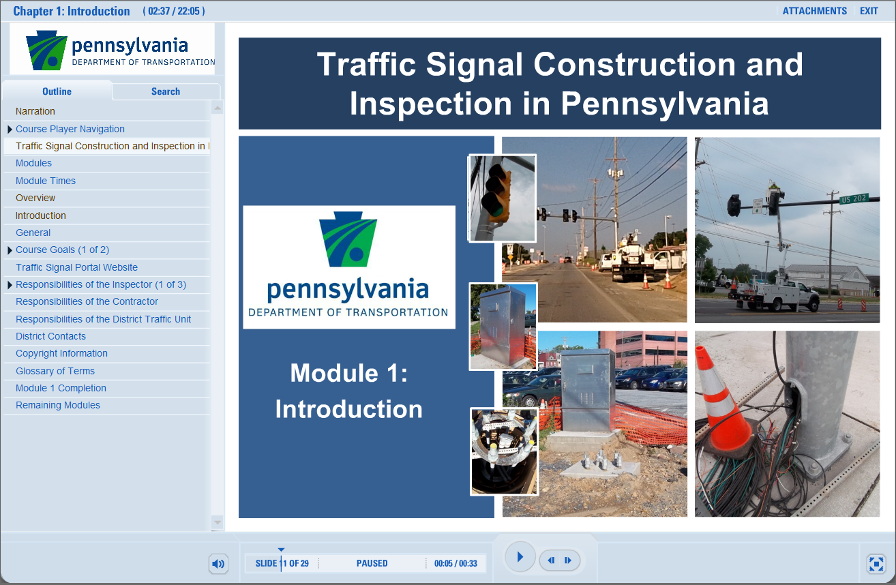
Course Player Navigation
Notes:
This online course contains several navigation tools that will be discussed in the following slides.

Slide 3
Outline
Outline
Notes:
The main navigation tool is the outline view. Click on any title on the left-hand side to jump to that section.

Slide 4
Volume Button
Volume
Notes:
To adjust the volume of the narration, click on the volume button or use the volume on your computer or speakers.

Slide 5
Pause/Play Button
Pause/Play
Notes:
The “Pause/Play” button will pause the course, or play the course after pausing.

Slide 6
Previous/Next Button
Previous/Next
Notes:
Use the “Previous/Next” buttons to move between slides.

Slide 7
View Button
View
Notes:
The “View” button will allow you to toggle between three different views.

Slide 8
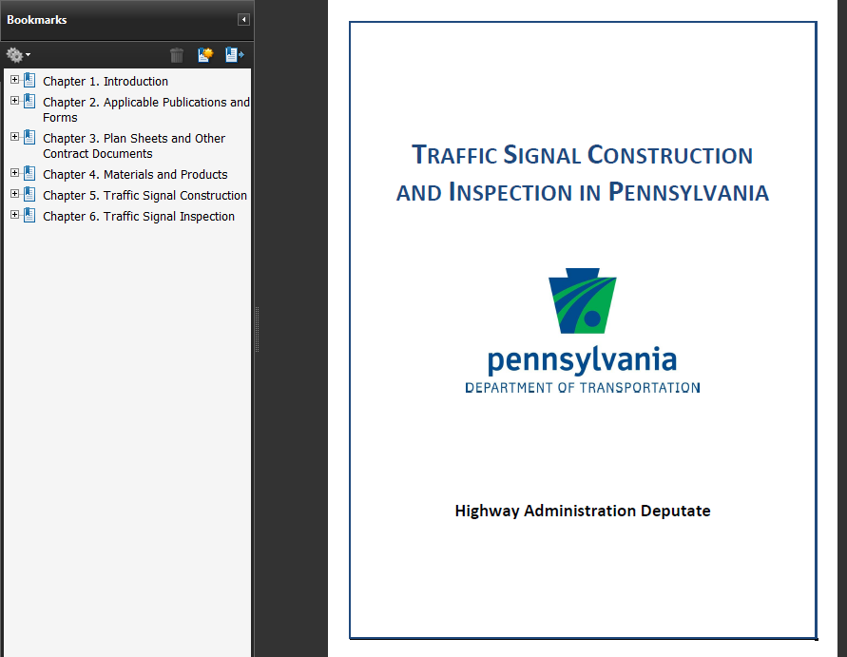
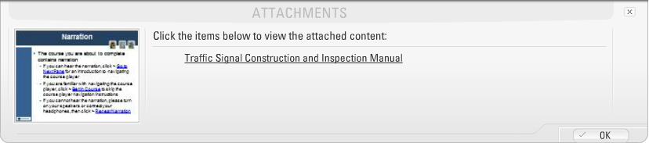
Attachments
Attachments
Notes:
To download course attachments, click on the “Attachments” link and choose the available attachment. Once you have viewed the attachments, click the “OK” button to continue the course.
This Traffic Signal Construction and Inspection Course does include a PDF Manual. You should download this course manual and save it to your computer. During portions of the course, you will be referenced to specific sections in the manual.
If you wish, the manual can be printed. It is designed to be printed double sided but can be single sided if you prefer. If you view this in electronic format, the use of dual monitors is convenient with one for the course player and one for the course manual.

Slide 9
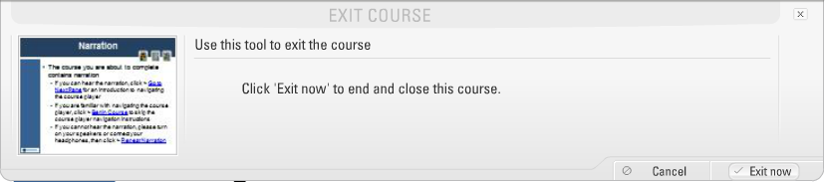
Exit
Exit
Exit Now
Notes:
To exit the course, click “Exit”. To confirm that you want to exit the course, click “Exit Now”. If you begin the course again later, you will be asked if you would like to continue the course were you left off.

Slide 10
Time Information
Time Elapsed/Remaining
Notes:
The course player does include an elapsed and remaining timer as shown here.

Slide 11

Traffic Signal Construction and Inspection in Pennsylvania
Module 1:
Introduction
Notes:
Welcome to the Traffic Signal Construction and Inspection in Pennsylvania e-learning course. This is the first of 6 modules and serves as an introduction to the course. This course does require the course manual. It is available in PDF format by clicking on “Attachments” in the course player. If you have not downloaded this, please do so now. Once you have the manual, return to the course player and click the “Next” button to continue the course.

Slide 12
Modules
Modules Covered in Workshop
  Module 1 – Introduction
  Module 2 – Applicable Publications and Forms
  Module 3 – Plan Sheets and Other Documents
  Module 4 – Materials and Products
  Module 5 – Traffic Signal Construction
  Module 6 – Traffic Signal Inspection

Slide 13
Module Times
Module Times
Module | Narration Time (Min) | Review Time (Min)
1 | 21 | 15
2 | 15 | 10
3 | 14 | 10
4 | 38 | 25
5 | 65 | 45
6 | 83 | 50
Exam | 30 | 15
Total | 236 min (3.9 hrs) | 155 min (2.6 hrs)
Notes:
The following table has been developed to let you see how long it requires to complete the Traffic Signal Construction and Inspection course.
The first column list the module and the exam. The second column shows the narration time with the amount of time listed in minutes. This is the amount it wil ltake to start the player and proceed through, non-stop.
The 3rd column, review time indicates the amount of time you will want to take to review the slides you just went over and to look at the notes in the course manual.
You can see that it will take approximately 4 hours to complete the narration and approximately 2.6 hours to review the materal.
You can stop and break at anytime. When you launch the training course again, you will be asked if you would like to resume the course where you left off.

Slide 14
Overview
One-day Traffic Signal Construction and Inspection Course
Approx. ½ Construction and ½ Inspection
Overlap between Construction and Inspection
Information Specific to the Commonwealth
Fundamental Concepts and Standard Practices in Pennsylvania
Notes:
This online e-course was originally developed as an instructor lead course that was one-day in length. Approximately ½ of the material is focused on construction and the other ½ on inspection. However, there is significant overlap between these two topics. The information in this course is, in general, specific to the commonwealth and covers the fundamental concepts and practices in PA.

Slide 15

Introduction
Manual Section 1.1
Designed for those involved with construction and inspection
Overview of contract documents
Construction requirements
 | Neither the manual nor the e-training is intended as substitutes for actual contract documents.
Notes:
The manual and e-learning course have been developed for those involved in construction and inspection. Throughout this e-learning course, certain slides will indicate the section of the manual to refer to (as shown here).

Slide 16
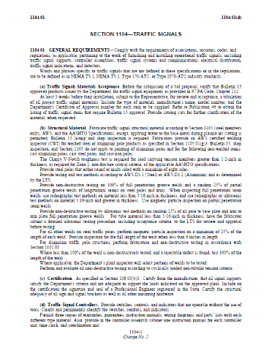
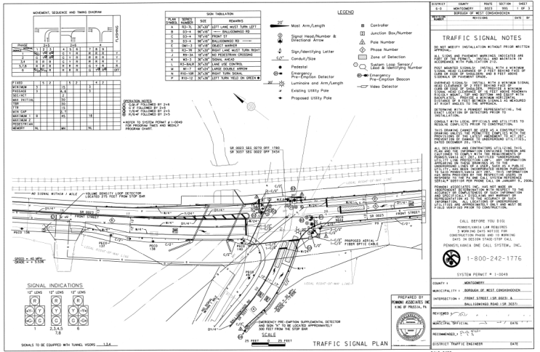
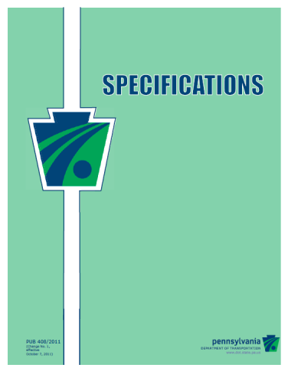
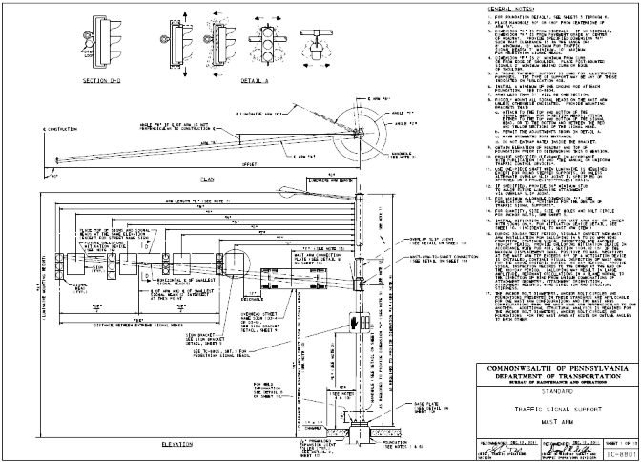
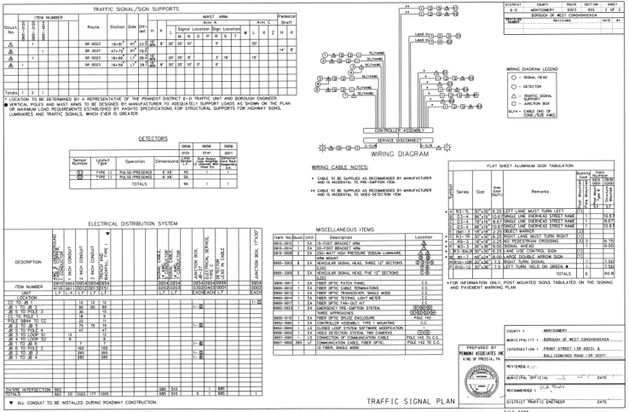
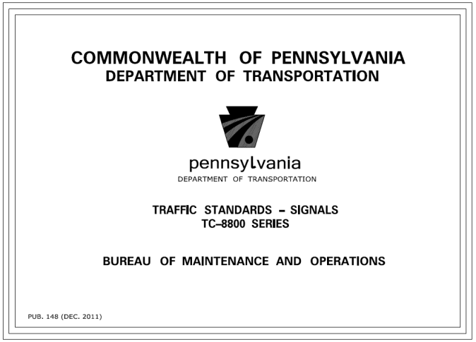
General
Manual Section 1.2
Traffic signal projects must comply with contract documents
  Specifications
  Plans
  Standard Drawings
  Etc.

Slide 17
Course Goals
Manual Section 1.4
Locate applicable traffic signal catalog cuts / specifications
Describe the applicable traffic signal proprietary approvals
List the traffic signal product approvals process
List the important sections of Publication 408 (Specifications) and its requirements

Slide 18
Course Goals
Understand and navigate Publication 669 (Traffic Signal Inspection Pocket Guide)
Traffic signal testing procedures
Develop and modify a traffic signal inspection Form

Slide 19
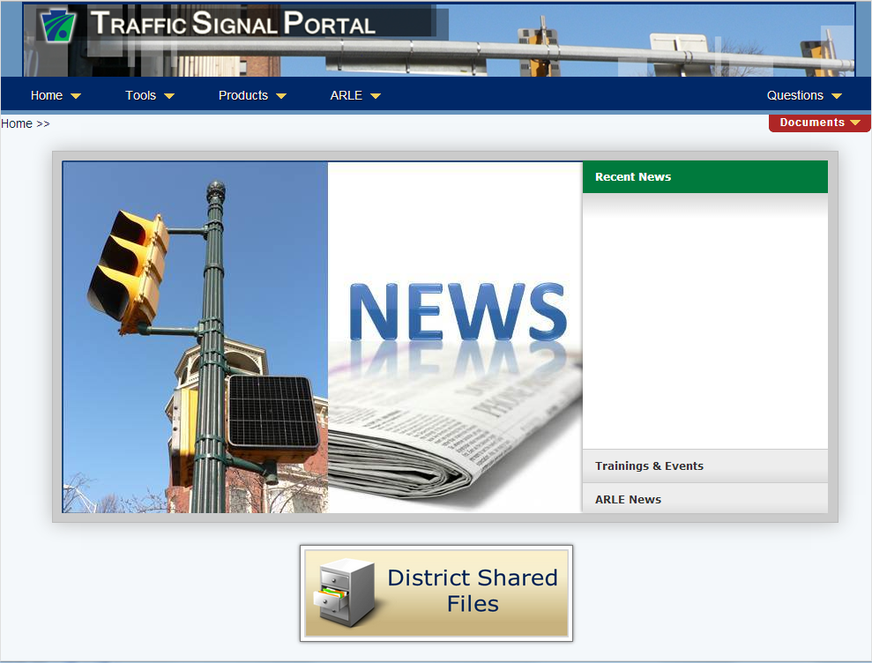
Traffic Signal Portal Website
Manual Section 1.5
Traffic Signal Portal Website
Notes:
The department has created and maintains a traffic signal portal website. The URL for the site is shown in Section 1.5 of the training manual. In this e-course, click on the image of the website to open your browser to that website. At this time, please do click on the image and discover the items found on this site. Also note the link to “Documents” listed on the right side of the portal. Here, you can find a large variety of publications, policies, forms and other documents related to traffic signals.
When you have finished investigating the portal, return to this e-course and select the “Next” button to continue.

Slide 20

Responsibilities of the Inspector
Manual Section 1.6
Work with the contractor
  Ensure completed safely
  Proper protection of employees
Verify work done according to contract documents
Coordination of work and utilities
For Department projects, coordinate with the District Traffic Unit for changes to structure locations

Slide 21
Responsibilities of the Inspector
For HOP projects, coordinate with municipality for changes of item locations
Verify setup prior to “Turn-on”
Monitor and record changes
Verify materials on CS-201 used

Slide 22
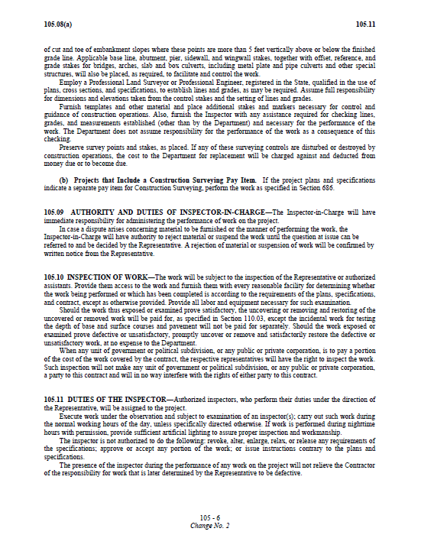
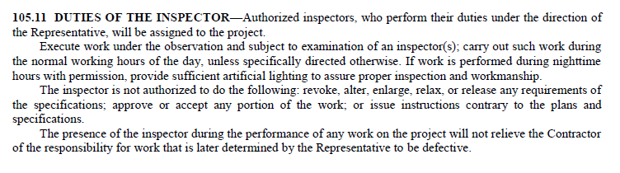
Responsibilities of the Inspector
From Publication 408, Section 105.11

Slide 23
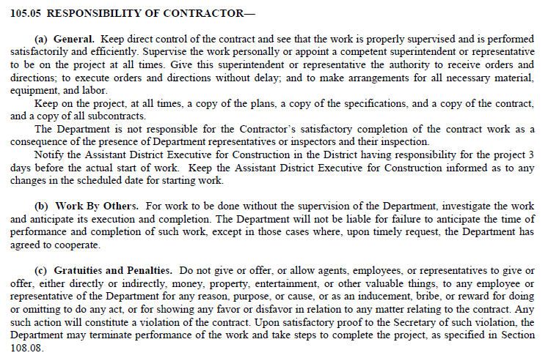
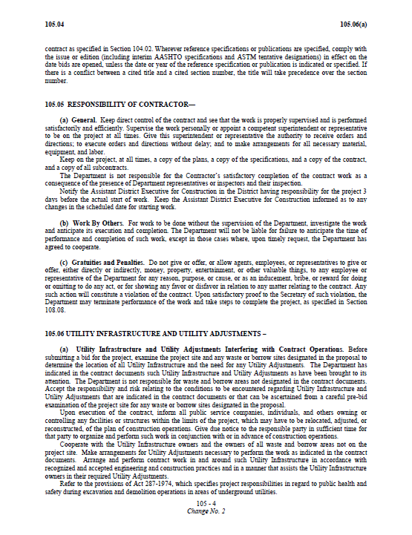

Responsibilities of the Contractor
Manual Section 1.7
From Publication 408, Section 105.05

Slide 24
Responsibilities of the District Traffic Unit
Manual Section 1.8
For Department projects, support the inspector
For Department projects, technical assistance to the Inspector
Work with inspector to instruct the traffic signal contractor
Verify (with inspector) setup prior to “Turn-on”
Monitor and be available for questions during 30-day test period
Review materials submitted on CS-201

Slide 25
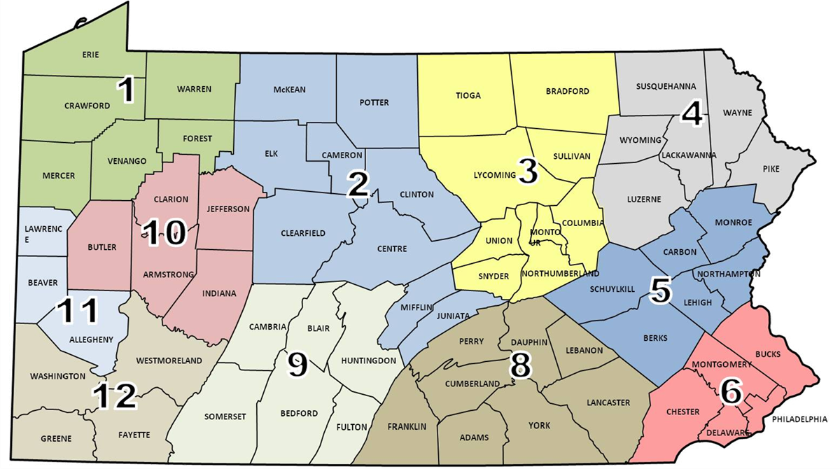
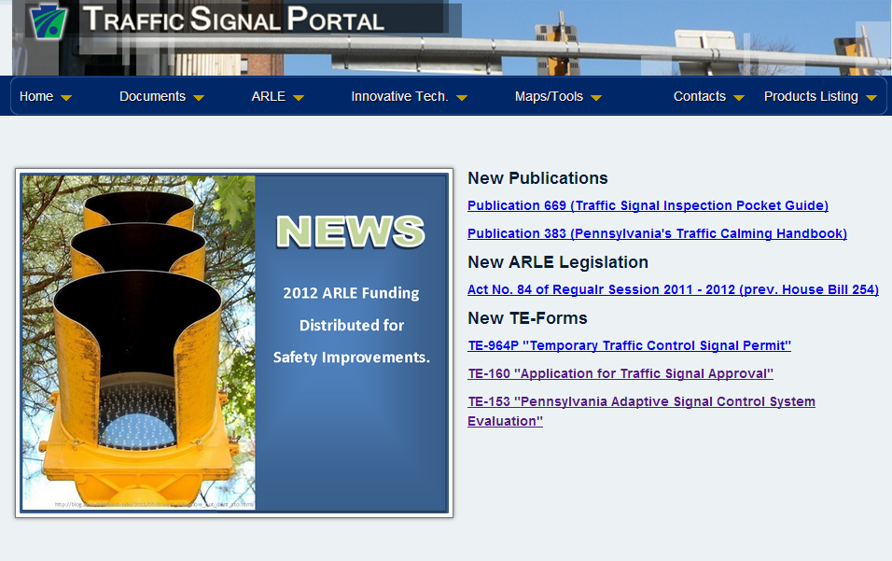
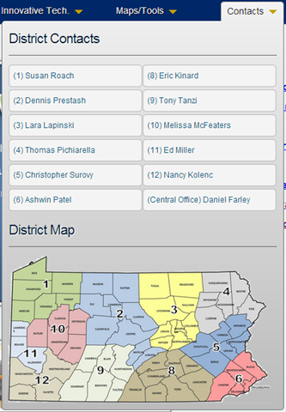
District Contacts
Manual Section 1.9
From the Traffic Signal Portal
Notes:
The traffic signal portal does include a list of district contract. These contacts are also listed in Section 1.9 of the training manual. Please note, these names were current at the time of this publication, however, the names could have changed. For the most up to date contacts, please check on the traffic signal portal.

Slide 26
Copyright Information
Copyright © 2013 by the Commonwealth of Pennsylvania. All rights reserved. No part of this publication may be reproduced, stored in a retrieval system, or transmitted in any form or by any means electronic, mechanical, photocopying, recording or otherwise without prior written permission by PennDOT.
This training course was developed in partnership with the Pennsylvania Department of Transportation’s Business Leadership and Administrative Services Office and the Highway Safety and Traffic Operations Division, and Albeck + Associates, Inc. It is offered as part of the Pennsylvania Department of Transportation’s Highway Administration Comprehensive Training Plan exclusively through the Technical Training and Development Section.
Next Slide
Notes:
Please take a moment to read the copyright information.
When ready, click the button to proceed to the Glossary of Terms.

Slide 27
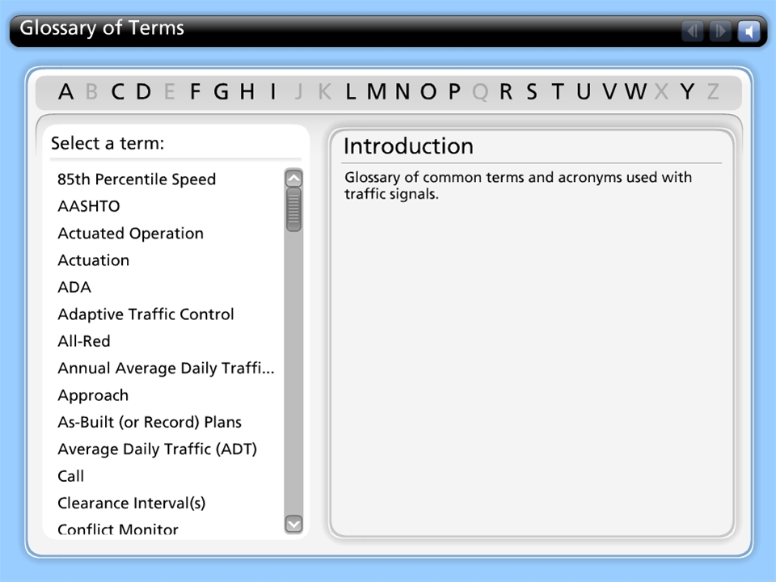



Glossary of Terms

Slide 28
Module 1 Completion
You have now completed module 1, Introduction
To review any section in this module, use the “Outline” on the left
The next module is module 2, Applicable Publications and Forms
It is suggested that you complete module 2 before proceeding to the additional modules

Slide 29
Remaining Modules
The remaining modules include:
  Module 2: Applicable Publications and Forms
  Module 3: Plan Sheets and Other Contract Documents
  Module 4: Materials and Products
  Module 5: Traffic Signal Construction
  Module 6: Traffic Signal Inspection
Return to the PennDOT Technical Training Calendar to select Module 2

