Slide 1

Traffic Signal Construction and Inspection in Pennsylvania
Module 2:
Applicable Publications and Forms

Slide 2
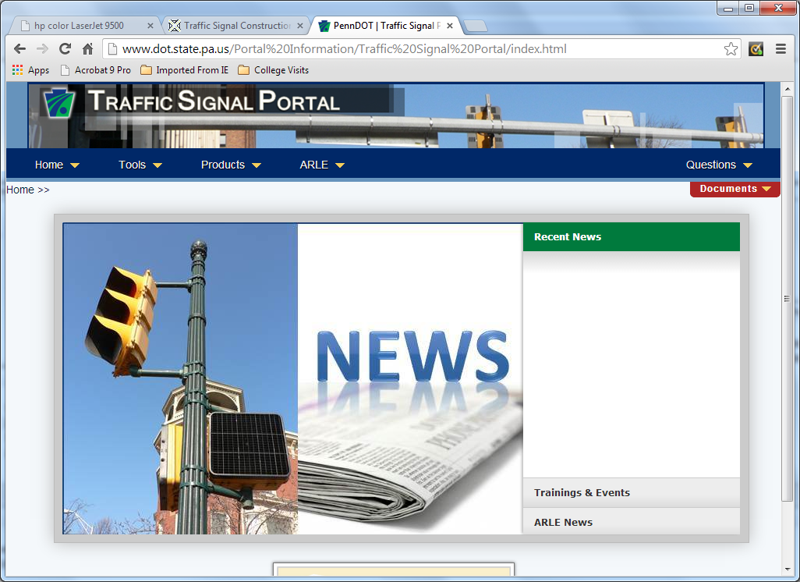
Chapter 2 Introduction
Latest version of manuals and forms on Traffic Signal Portal
Continually check for updates
Notes:
The publications and forms presented in this module are current at the time of the recording. However, the documents are subject to change. It is important to continually check for updates of these documents by visiting the traffic signal portal. You can go there now by clicking on the image in this slide. Click next when you are ready to proceed.

Slide 3
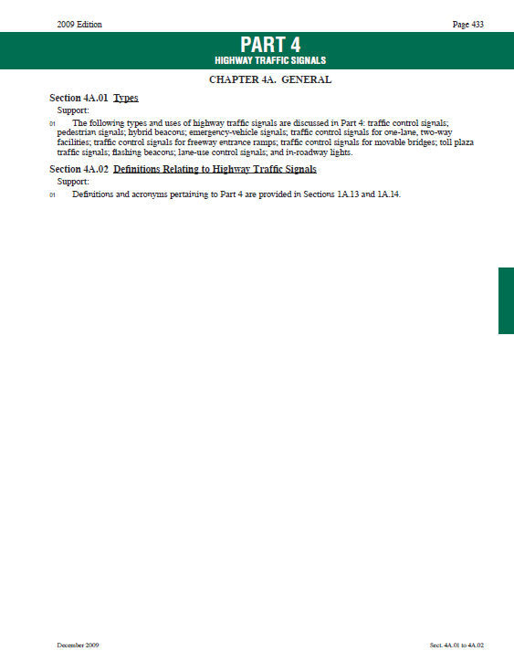
Manual on Uniform Traffic Control Devices
Manual Section 2.1
Manual on Uniform Traffic Control Devices (MUTCD)
  Published by the Federal Highway Administration
  Contains national design, application, and placement standards, guidance, options, and support provisions for traffic control devices
  http://mutcd.fhwa.dot.gov/index.htm

Slide 4
Manual on Uniform Traffic Control Devices
Title 23 of the Code of Federal Regulations (CFR)
Requires states to:
    adopt the new or revised national MUTCD as the standard for traffic control devices in the state;
    adopt the national MUTCD with a state supplement that is in substantial conformance with the new or revised national MUTCD; or
    adopt a state MUTCD that is in substantial conformance with the new or revised national MUTCD.

Slide 5
Publication 669 – Traffic Signal Inspection Pocket Guide
Manual Section 2.2
Assists the inspector in:
  recognizing the components of a traffic signal
  ensuring all contract requirements are met
  as a roadmap to the PennDOT traffic signal requirements

Slide 6
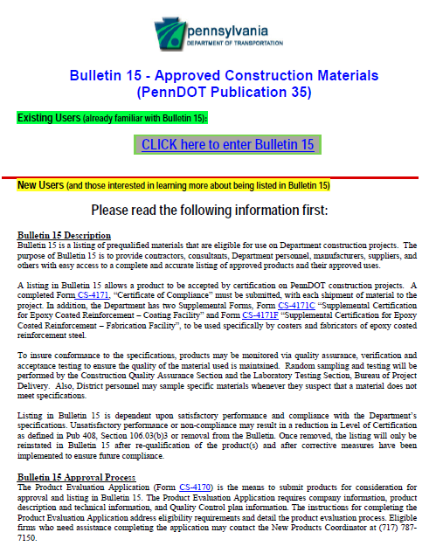
Publication 35 – Bulletin 15 Approved Material
Manual Section 2.3
Listing of prequalified materials eligible for use on Department construction projects
Provides contractors, consultants, Department personnel, manufacturers, suppliers, and others with easy access to a complete and accurate listing of approved products and their approved uses

Slide 7
Publication 46 – Traffic Engineering Manual
Manual Section 2.4
Publication 46 – Traffic Engineering Manual
  Publication 46 is the Department’s Traffic Engineering Manual
  Chapter 4 is focused on traffic signals

Slide 8
Publication 72M – Standards for Roadway Construction
Manual Section 2.5
Publication 72M is the Department’s Roadway Construction Standards

Slide 9
Publication 111 – Traffic Control Pavement Markings and Signing Standards
Manual Section 2.6
Publication 111 is the Department’s standard drawings to be used for the design, details and installation for traffic control Signs and Pavement Markings

Slide 10
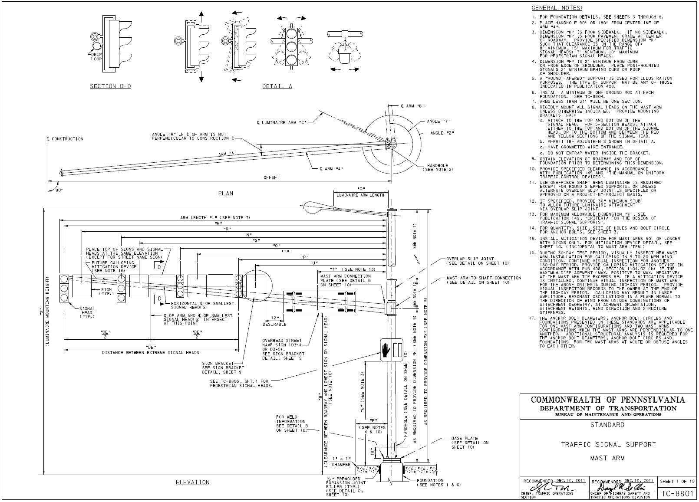
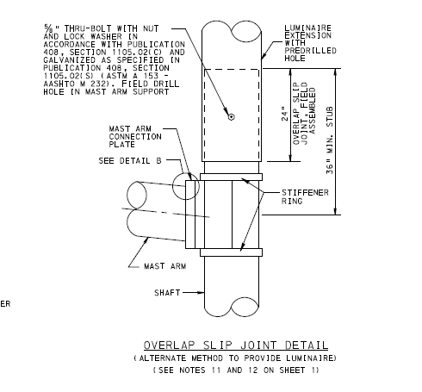
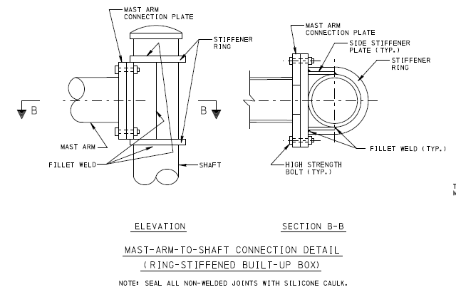
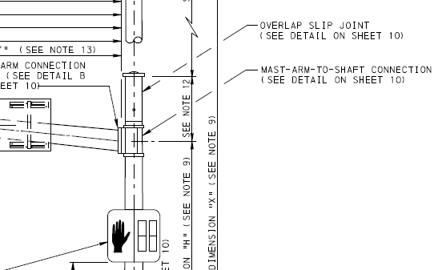
Publication 148 – Traffic Standards (Signals, TC-8800 Series)
Manual Section 2.7
Publications
  Publication 148 – Traffic Standards (Signals, TC-8800 Series)
    Publication 148 is the Department’s traffic signal standards
    This includes standard drawings for a variety of traffic signal components
    TC-8801 to TC-8806 included
Standard Drawing No. | Description
TC-8801 | Traffic Signal Support
TC-8802 | Controller Assembly
TC-8803 | Miscellaneous
TC-8804 | Electrical Distribution
TC-8805 | Signal Heads
TC-8806 | Detectors

Slide 11
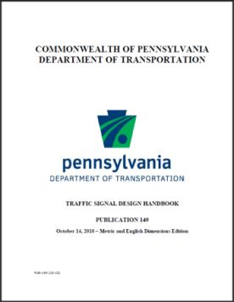
Publication 149 – Traffic Signal Design Handbook
Manual Section 2.8
Publication 149 - The Department’s Traffic Signal Design Manual
  Purpose is to provide design guidance when developing a new, or modifying an existing, traffic signal in Pennsylvania
  Provides the necessary guidance in preparing appropriate construction and traffic signal permit plans

Slide 12
Publication 212 – Official Traffic Control Devices
Manual Section 2.9
Publication 212 - The Department’s Official Traffic Control Devices
  Contains the regulation, Chapter 212 of Title 67 of the Pennsylvania Code (67 Pa. Code Chap. 212)

Slide 13
Publication 213 – Temporary Traffic Control Guidelines
Manual Section 2.10
Publication 213 is the Department’s Temporary Traffic Control Guidelines

Slide 14
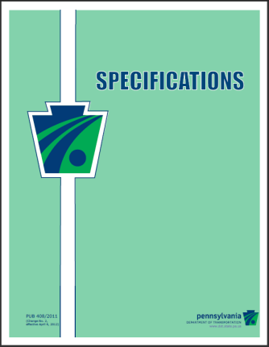
Publication 408 – Standard Specifications
Manual Section 2.11
Publications
  Publication 408 – Highway Specifications
    Publication 408 provides the Department’s highway construction specifications and details specifications for most highway construction projects
    Section 900 is related to traffic control, Section 1000 on structures and Section 1100 on manufactured materials

Slide 15
Publication 408 – Standard Specifications
Publications
  Navigating Through Publication 408
Click here to go to the Construction Specifications (Publication 408)

Slide 16
Form CS-201, Source of Supply – Traffic Items
Manual Section 2.12
Form CS-200 Source of Supply–Materials
Form CS-201 Source of Supply–Traffic Items
More details later in course
Notes:
Preapproved traffic signal support drawings
Catalog cuts (get on controller or mast arm)
Get examples from D6

Slide 17
Form 4170, Product Evaluation Application
Manual Section 2.13
The means to submit products for consideration for approval and listing in Bulletin 15

Slide 18
Form 4171, Certificate of Compliance
Manual Section 2.14
Form 4171, “Certificate of Compliance” must be submitted, with each shipment of material to the project

Slide 19
Handout – Publication 408 Sec. 1104
Handout of Publication 408, Section 1104 included in the manual
Only included as an illustration
Be sure to download the latest copy!
Click here to go to the Construction Specifications (Publication 408)

Slide 20
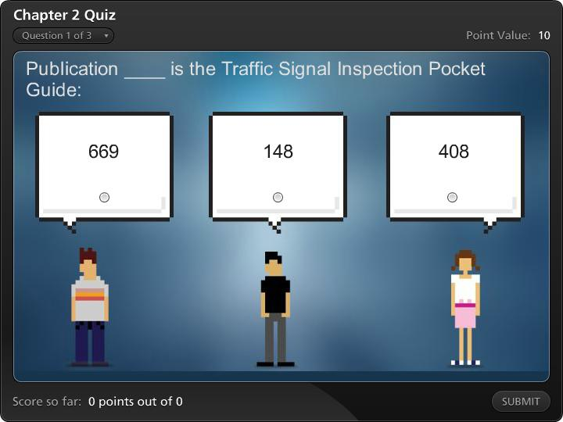



Chapter 2 Quiz

Slide 21
Module 2 Completion
You have now completed Module 2, Applicable Publications and Forms
To review any section in this module, use the “Outline” on the left
Up next is Module 3, Plan Sheets and Other Contract Documents
It is suggested that you complete Module 3 before proceeding to the additional modules

Slide 22
Remaining Modules
The remaining modules include:
  Module 3: Plan Sheets and Other Contract Documents
  Module 4: Materials and Products
  Module 5: Traffic Signal Construction
  Module 6: Traffic Signal Inspection
Return to the PennDOT Technical Training Calendar to select Module 3

