Slide 1

Traffic Signal Construction and Inspection in Pennsylvania
Chapter 3:
Plan Sheets and Other Contract Documents
Notes:
Welcome to Module 3 of the Traffic Signal Construction and Inspection in Pennsylvania e-learning course. In this module, we will discuss traffic signal plan sheets and related contract documents.

Slide 2
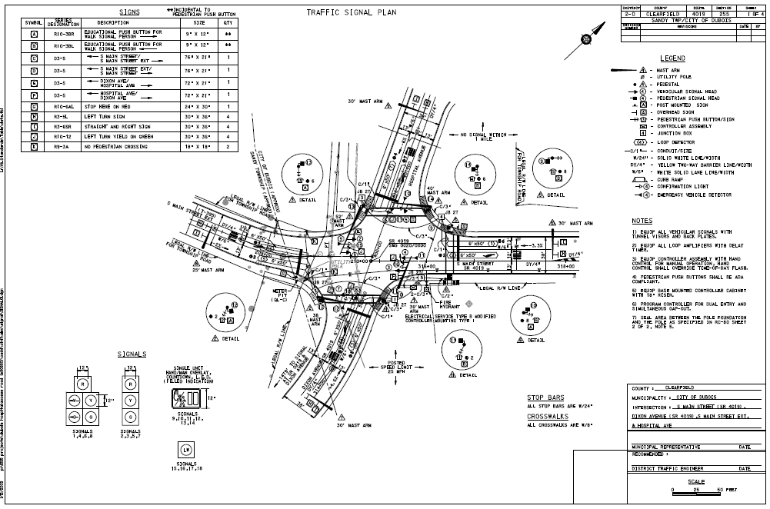
Traffic Signal Plans
Manual Section 3.1
Purpose of a Signal Plan
  Important document that illustrates the placement (proposed or existing) of the components required for a traffic signal installation

Slide 3
Purpose of a Signal Plan
Purpose of a Signal Plan
  The plan is used for, but is not limited to, the following:
    The permit process (permit plan)
    Facilitating the contractor’s bid
    Building the signal (construction plan)
    Operating/maintaining the signal
    Signal locates
    Tort claims/lawsuits

Slide 4
Traffic Signal Plan Items (1 of 2)
Traffic Signal Plan
  Plan Includes:
    Construction baseline
    Roadways, shoulders, curbs, curb ramps, sidewalks, islands, inlets, and all utilities
    Pavement markings
    Signal supports, controller, junction boxes, signal heads, detectors, pedestrian accommodations, and luminaires
    Movement, phasing, and sequence chart, including preemption and emergency flashing operation
    Electrical distribution
    Structure sizes, location, offsets, and orientation relative to the construction baseline
    Tabulation of quantities

Slide 5
Traffic Signal Plan Items (2 of 2)
Traffic Signal Construction Plans
  Typical information found in a Traffic Signal Plan sheet includes the following
    Sign Tabulation
    Movement, Phasing and Sequence Chart
    Phasing Diagram
    Signal Identification
    Legend

Slide 6
Traffic Signal Construction Plans (1 of 2)
Traffic Signal Construction Plans
  Typical information found in a Traffic Signal Plan sheet includes the following
    Sign Tabulation
    Movement, Phasing and Sequence Chart
    Phasing Diagram
    Signal Identification
    Legend

Slide 7
Traffic Signal Construction Plans (2 of 2)
  List Continued:
    Title Block
    Notes
    Signal Wiring Diagram
    Upper Title Block
    Intersection Layout
    Traffic Signal Supports
    Electrical and Conduit Items
    Detectors
    Miscellaneous

Slide 8
Parts of a Construction Plan
Parts of a Construction Plan

Slide 9
Movement, Sequence and Timing Chart
Movement, Sequence and Timing Chart

Slide 10
Emergency Pre-emption Phasing Chart
Emergency Pre-emption Phasing Chart

Slide 11
Signals Legend
Signals Legend

Slide 12
Wiring Diagram
Wiring Diagram

Slide 13
Signature Block
Signature Block

Slide 14
Legend
Legend

Slide 15
Emergency Pre-Emption Notes
Emergency Pre-Emption Notes

Slide 16
Coordination Plan
Coordination Plan

Slide 17
Signing Table
Signing Table

Slide 18
Special Provisions
Manual Section 3.2
Should be written in accordance with Publication 51, Chapter 1, Section E, Special Provisions
Only items that are not standard Publication 408 items need a special provision
Consult the local PennDOT engineering District and/or Central Office to confirm if a standard special provision exists for an item that may be needed under a traffic signal design project
Notes:
Discuss what inspector does with the special provisions. Items not covered in pub 408.

Slide 19
Municipal Traffic Signal Specifications
Manual Section 3.3
Consideration should be given to municipal traffic signal specifications during the design process
If a municipality has an adopted technical specification for traffic signal installations, the designer and project owner should do their best to accommodate the municipality’s needs since the municipality is the permittee and ultimate owner of the traffic signal
Notes:
First bullet – that was taken into account during the design process. If the munic. Asks for something later, section in Pub 46. Section 408 has information too.

Slide 20

Coordination of Plans and Specifications
Manual Section 3.4
In case of a discrepancy among the contract documents, the following order of precedence will apply:
  Special Provisions
  Plans (excluding cited Standard Drawings)
  Specifications (other than Special Provisions)
  Standard Drawings

Slide 21
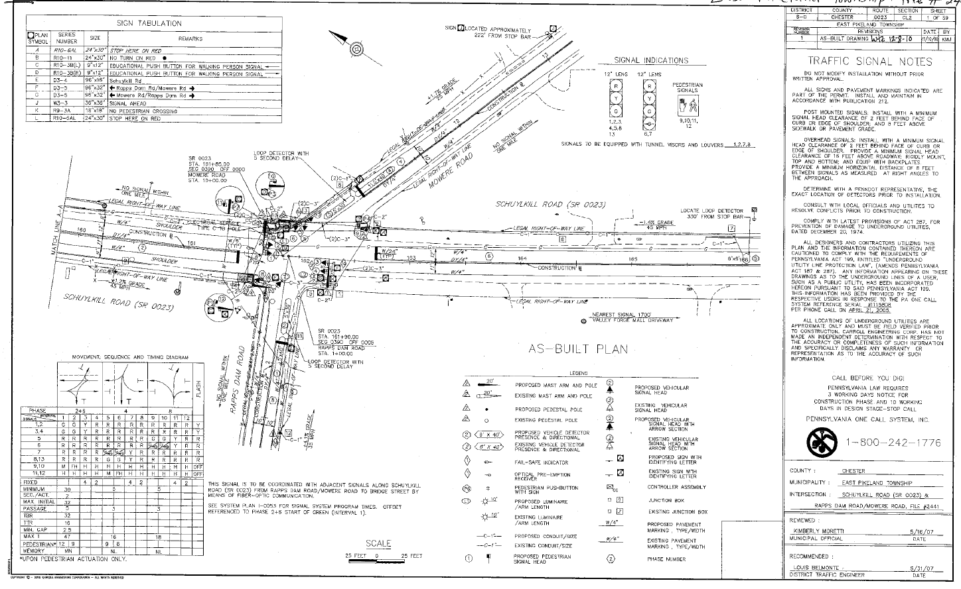
As-Built (Record) Plans
Manual Section 3.5
Once the signal installation has been accepted, as-built (record) drawings need to be made and sent in with the semi‐final records
Note for traffic signal projects are changes in:
  location of junction boxes
  vehicle signal heads
  conduit runs
  wiring
  pole locations
  utilities

Slide 22
Module 3 Completion
You have now completed Module 3, Plan Sheets and Other Contract Documents
To review any section in this module, use the “Outline” on the left
Up next is Module 4, Materials and Products
It is suggested that you complete Module 4 before proceeding to the additional modules

Slide 23
Remaining Modules
The remaining modules include:
  Module 4: Materials and Products
  Module 5: Traffic Signal Construction
  Module 6: Traffic Signal Inspection
Return to the PennDOT Technical Training Calendar to select Module 4

