Slide 1

Traffic Signal Construction and Inspection in Pennsylvania
Module 5:
Traffic Signal Construction

Slide 2
General
Manual Section 5.1
May be installed by:
  Contracts administered by local authorities
  Municipal forces
  Contracts related to highway occupancy projects
  Department construction contracts

Slide 3
General - Inspection
Local authorities are responsible for the inspection of the traffic signals that they have installed
District office provides inspection for signals that are included in
  Department contracts or
  Installed in conjunction with HOP issued by the Department for work on state highways

Slide 4
General - Costs
Costs associated with the installation of traffic signals are the responsibility of the municipality
Municipality may enter into an agreement with another party who assumes all or part of these costs

Slide 5
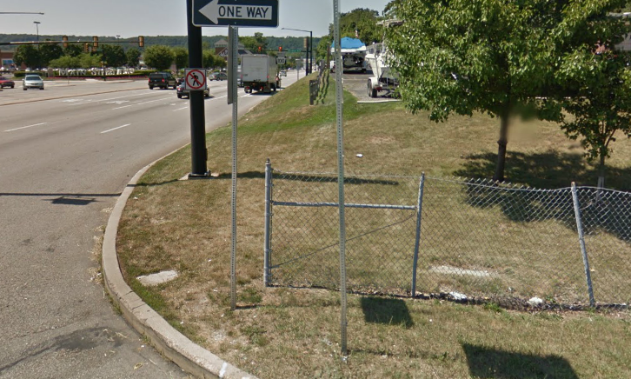
Pennsylvania One Call System
Manual Section 5.2
All excavators must contact PA One Call at least 3 business days prior to excavation, as required by law

Slide 6
Traffic Control
Manual Section 5.3
Traffic control for signal projects is detailed in Publication 213 – Temporary Traffic Control Guidelines

Slide 7
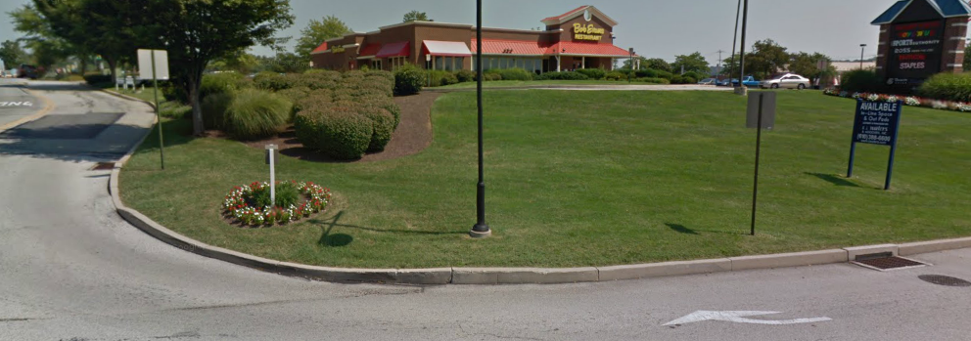
Staking
Manual Section 5.4
Locating the components of a traffic signal is not an exact science; many factors influence the location of the components

Slide 8
Staking Factors
Locating factors include:
  Lane widths
  Radii
  Crosswalks
  Cracks and joints in the pavement on existing roads
  Utilities below ground and overhead

Slide 9
Staking Time Estimate
It takes an experienced person approximately two to three hours to stake a signal
Using an experienced person to stake a traffic signal ensures
  efficient installation
  easy maintenance
  good operation

Slide 10
Order of Installation
Manual Section 5.5
Install the signal supports
Install the underground conduit and junction boxes
Install the controller cabinet and foundation
Install the grounding system
Install the electric power service
Install the span wire (if used)
Install the signal heads and pull cable back to the controller
Install the detection system and pull cable back to the controller

Slide 11
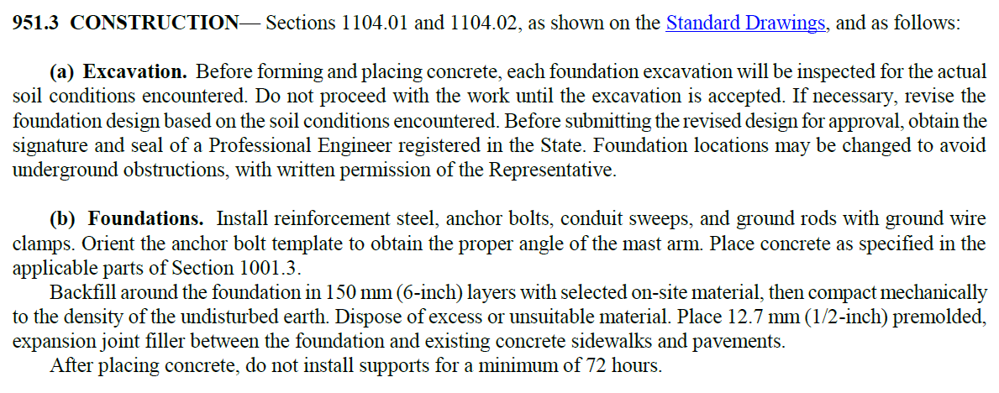
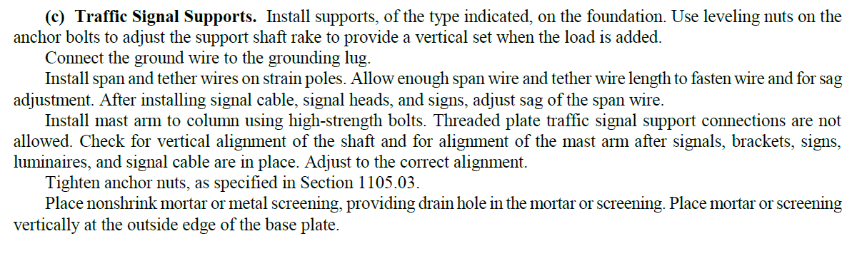
Construction from Pub 408
Publication 408, Section 951.3

Slide 12
Mast Arm Installation
Manual Section 5.6
First the mast arm foundation is installed, and then the mast arm assembly
  Locate the position of the pole in the field and dig the hole
  Prepare and set the reinforcing cage along with the anchor bolts
  Install underground conduit
  Pour the concrete
  Wait for the concrete to cure

Slide 13

Concrete Foundation Video

Slide 14
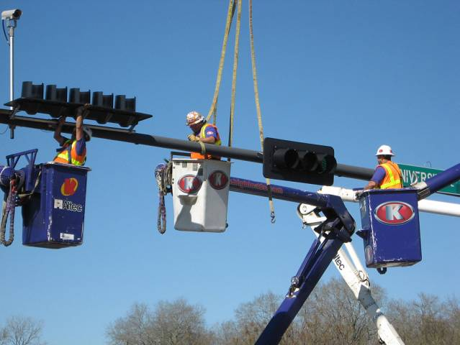
Mast Arm Installation
  Use a crane or boom truck to set the vertical portion of the mast arm assembly (the mast arm pole) and secure the mast arm pole to the anchor bolts with hexagonal nuts
  Use a crane to align the horizontal mast arm with the connection plate on the vertical pole and attach using hexagonal nuts
  Level the assembly using the hexagonal nuts located at the base of the mast arm pole

Slide 15
Mast Arm Features
Mast Arm Features
  Typically constructed of either steel or aluminum
  Bolted to a reinforced concrete foundation
  Poles are hollow for cable
  Into conduit in foundation to devices

Slide 16
Above Ground Components
Above Ground Components
  The above ground portion of the mast arm assembly consists of two major components:
    The mast shaft, which is the vertical component that provides structural strength.
    The mast arm itself, which is the horizontal component on which the signal heads are mounted.

Slide 17
Mast Arm Foundation
Mast Arm Foundation
  The mast arm foundation is composed of concrete with steel reinforcing

Slide 18
Preparing the Cage
Preparing the Cage
  The steel reinforcing in a mast arm foundation is commonly referred to as “the cage.”

Slide 19
Fix the Pole Position
Fix the Pole Position
  Using the plans as a guide and making note of the location of underground utility lines (as marked by the utility companies), the final location of the poles is established

Slide 20

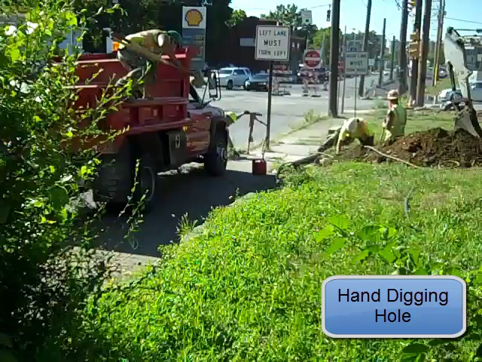
Hand Digging
Hand Dig the Hole
  First few feet
  Since utilities are not always properly located
  unknown utilities are sometimes present at a site

Slide 21
Auger Digging
Dig Rest of the Hole
  The remainder of the hole is then dug with automated auger equipment until the required hole depth is achieved

Slide 22
Hole Stabilization
Hole Stabilization
  Measures must be taken to ensure that the hole will not collapse
  Usually done in one of two ways:
    By inserting a sleeve into the hole
    By applying mineral slurry

Slide 23
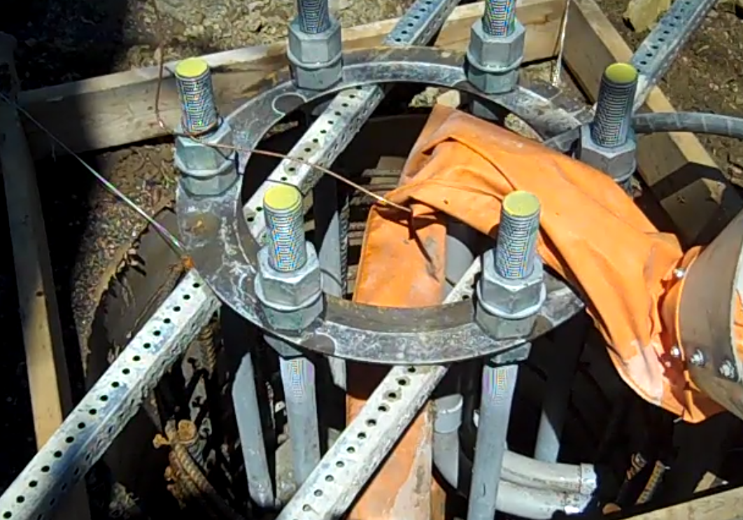
Sleeves
Types of Sleeves
  Two types of sleeves are commonly used:
    metal sleeves
    sleeves made of pressed cardboard coated with wax
Pressed Cardboard Sleeve

Slide 24
Setting the Cage
Setting the Cage
  Once the hole is dug and stabilized
    the cage is suspended into the hole using wooden supports
    concrete is poured around and through the cage until all voids are filled

Slide 25
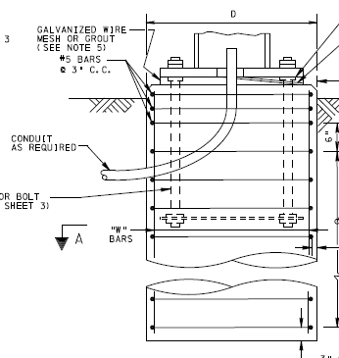
Conduits and Anchor Bolts
Installing Conduits
  Before the concrete is poured, all conduits entering the foundation must be installed

Slide 26

Concrete Curing
Concrete Curing
  Publication 408
    After placing concrete, do not install supports for a minimum of 72 hours

Slide 27
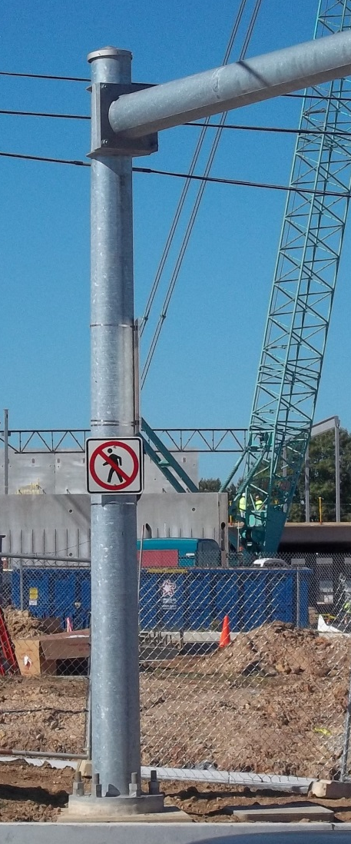
Setting the Mast Arm Pole
Setting the Mast Arm Pole
  A typical 21’ steel shaft (the vertical portion of the mast arm assembly) weighs less than 1500 lbs
  A crane is used to lift the pole and, with the assistance of a person on the ground, the pole is guided onto the anchor bolts

Slide 28
Protecting From Nearby Electrical Lines
Protecting From Nearby Electrical Lines
  Electrical lines that are in close proximity to support poles (or to span wires) will typically be “rubberized” during construction

Slide 29
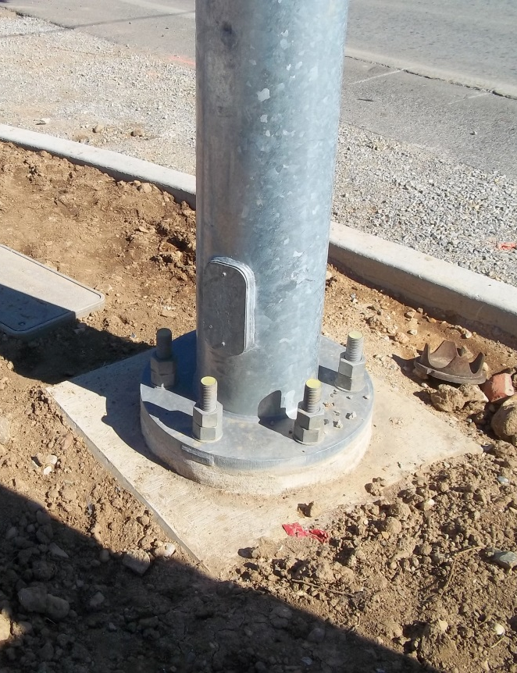
Securing the Mast Arm Pole
Securing the Mast Arm Pole
  The mast arm pole is then secured to the foundation by a series of hexagonal nuts that are attached to the anchor bolts

Slide 30
Leveling Nuts
Leveling Nuts
  On each anchor bolt, a hexagonal nut is placed below the base plate of the mast arm pole

Slide 31
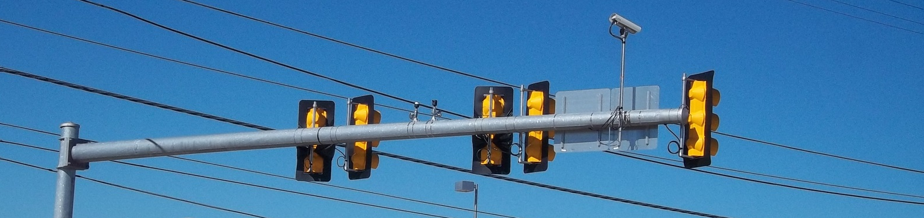
Attaching the Mast Arm
Attaching the Mast Arm
  A crane is needed to lift up the horizontal portion of the mast arm to meet the mast arm pole to attachment
  Hexagonal bolts are used to secure the mast arm to the mast arm pole at the attachment plate

Slide 32
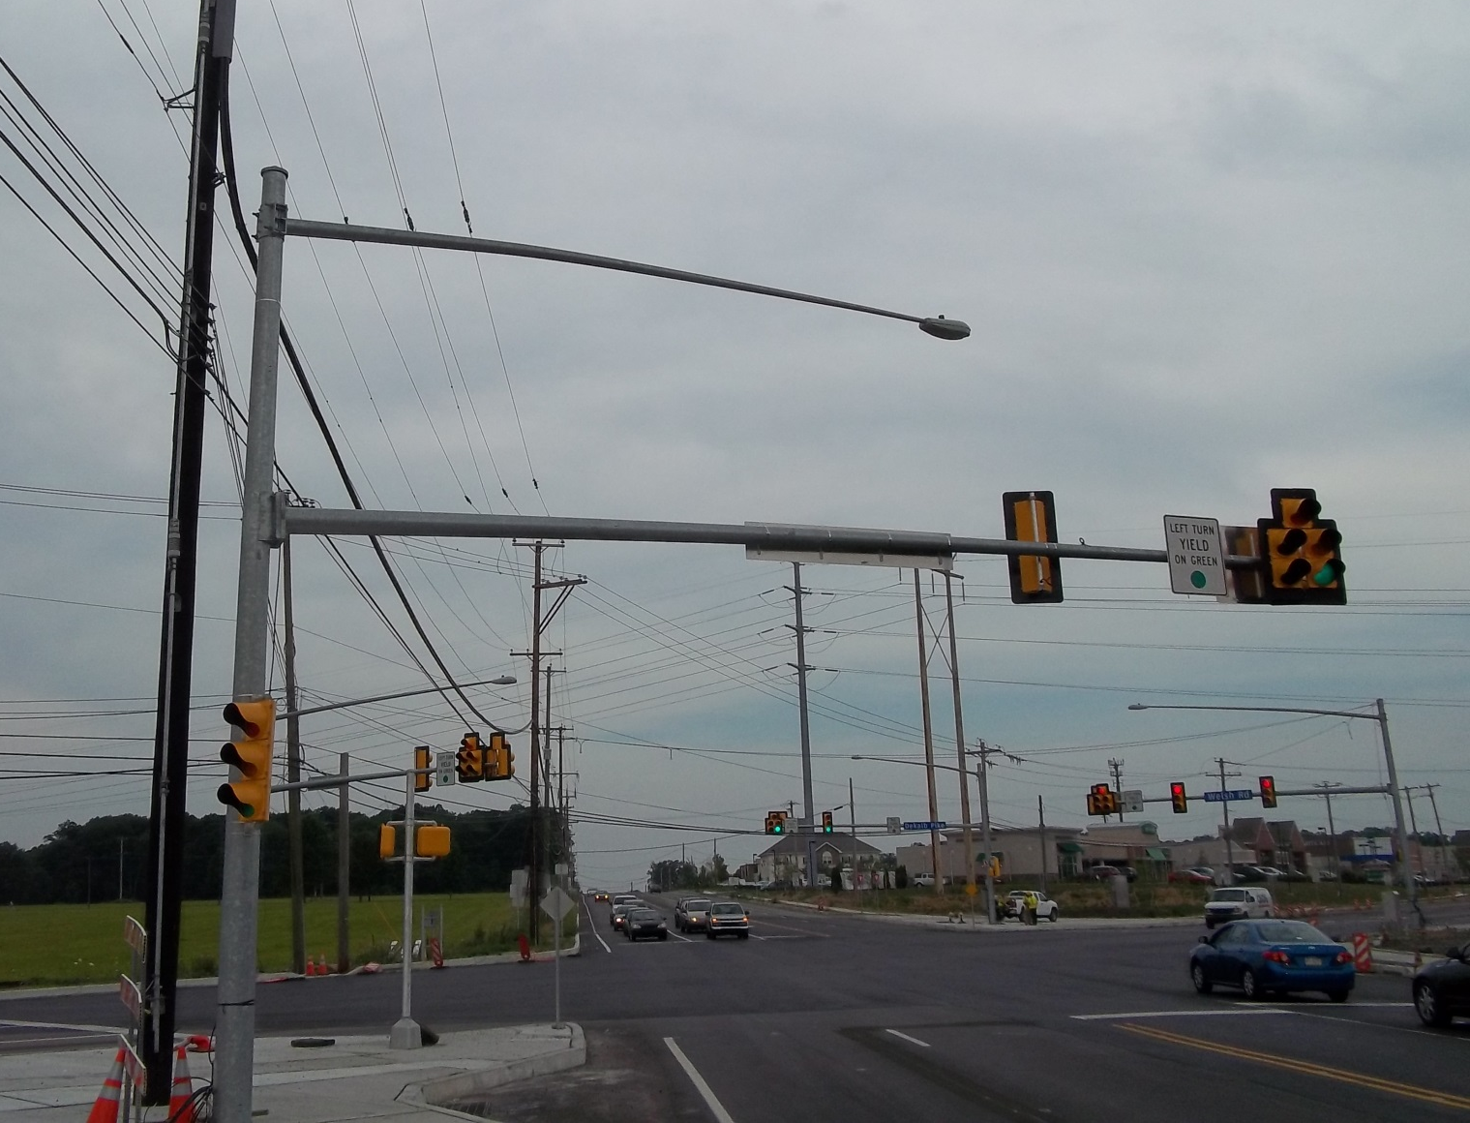
Mast Arm Sag
Mast Arm Sag
  The amount of sag of the mast arm depends on the stiffness of the mast arm, with stiffer mast arms having less sag
  Sag that is 2% of the mast arm length is typical
  Consequently, 50’ mast arm will usually have about 1’ of sag

Slide 33
Orienting the Mast Arm
Orienting the Mast Arm
  Most mast arms are designated to resist loading in a particular direction and the mast arm must be installed so that the correct side faces upwards
  If the mast arm is installed sideways or upside-down, the arm will experience an excessive amount of sag.

Slide 34
Proper Handling of Mast Arms
Proper Handling of Mast Arms
  Mast arms must be properly handled during installation to ensure that members are not inadvertently bent and to ensure that portions of the galvanized or painted surface are not accidentally scraped off
  However, even with careful handling, a certain amount of touch-up is usually required

Slide 35
Wind Effects on Unloaded Mast Arms
Wind Effects on Unloaded Mast Arms
  If a mast arm is left for an extended period of time with no load on it (in other words, with no signal heads attached), a steady wind can cause the arm to oscillate

Slide 36

Oscillation Video

Slide 37
Oscillation Dampers
Oscillation Dampers for Galloping Mitigation
  Oscillation due to wind effect can be a problem even with loaded mast arms

Slide 38
Steel Strain Pole Installation
Manual Section 5.7
Steel Strain Pole Installation
  The installation of a steel strain pole occurs in a manner very similar to that for mast arm poles, with a reinforced foundation being poured before the pole is set
Raking the Pole
  Strain poles are usually installed so that they are tilted slightly away from the direction of the load

Slide 39
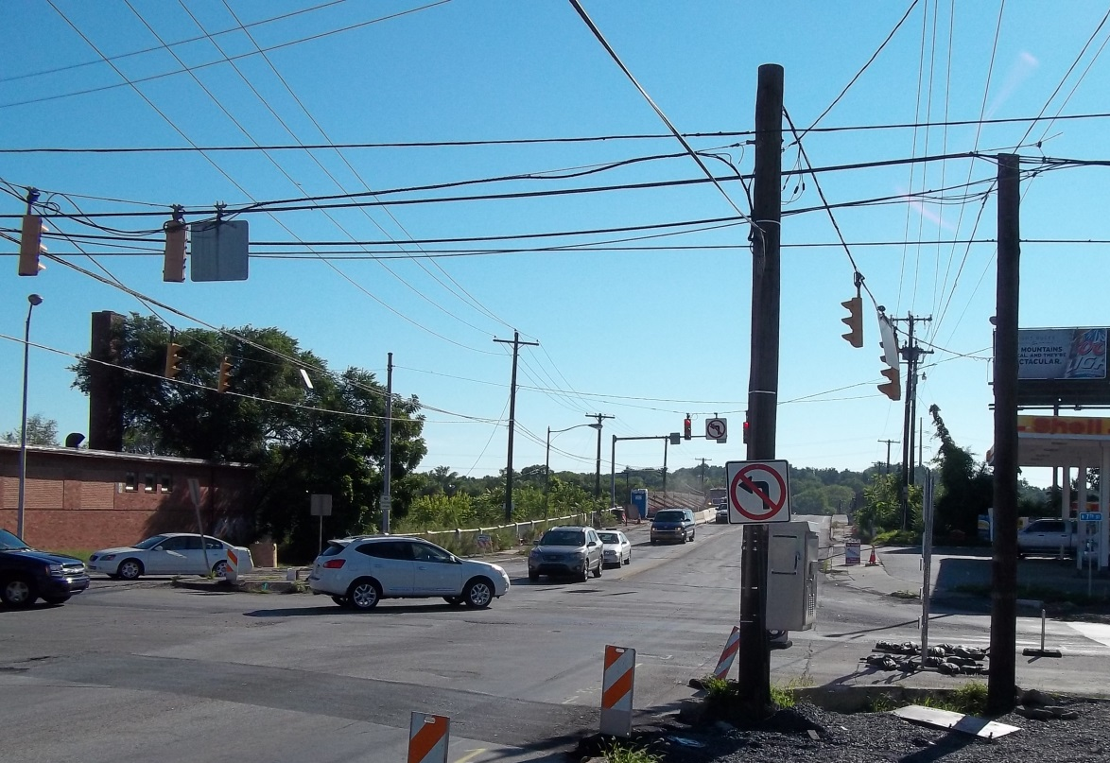
Install Wooden Signal Supports
Manual Section 5.8
Install Wooden Signal Supports
  wooden poles are typically used for temporary traffic control signals

Slide 40
Wood Strain Pole Installation
Wood Strain Pole Installation
  A wood strain pole is typically installed using the following tasks:
    Fix the position of the pole in the field
    Hand-dig first few feet of the hole
    Dig the remainder of the hole using an auger
    Use crane to remove pole from delivery truck and set in hole
    Install underground conduit
    Backfill hole with concrete or tampered dirt
    Allow concrete to strengthen before loading the poles

Slide 41
Wood Strain Pole Installation (Cont’d)
Wooden Pole Classes
  Poles come in 10 classes
Backfilling the Hole
  Filled with dirt or concrete
Dealing with Water Intrusion
  Need to pump out water that has seeped in

Slide 42
Wood Strain Pole Installation (Cont’d)
Supporting the Pole
  Must be supported by crane during backfilling
Guying Wooden Poles
  Usually guyed opposite the load
Guy Anchors
  Various sizes and configurations

Slide 43
Junction Box and Conduit Installation
Manual Section 5.9
Junction boxes and conduits are used as raceways for carrying signal cable, loop wires, and communication cable to the controller cabinet

Slide 44
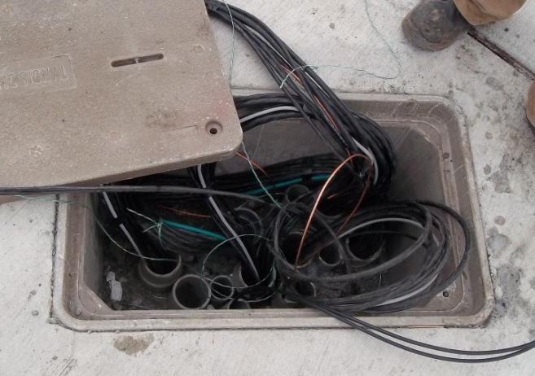
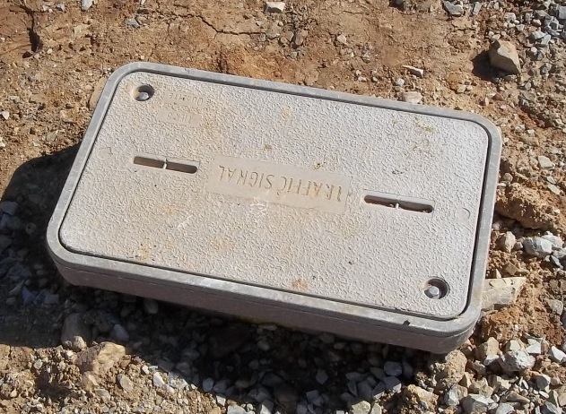
Junction Box and Conduit Installation

Slide 45
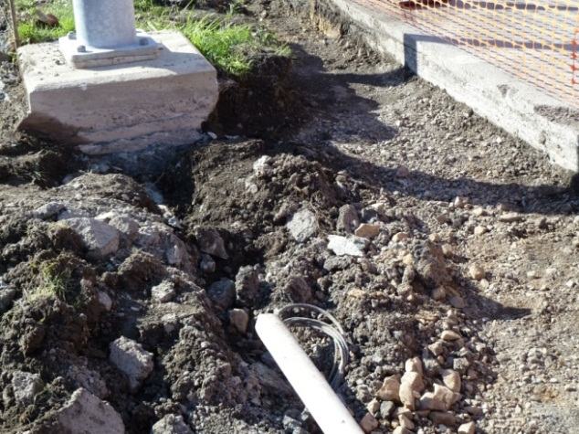
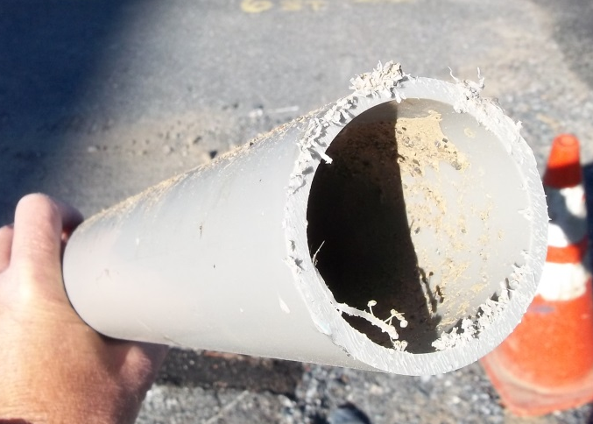
Junction Box and Conduit Installation

Slide 46
Junction Box Features
Junction Box Features
  A junction box is an underground storage compartment, typically rectangular in shape, with no bottom and a removable cover

Slide 47
Junction Boxes in Pub 408
Publication 408, Section 1104.05(b) indicates the following regarding junction boxes:
(c) Junction Box. Furnish the type indicated and as follows:
  Precast Junction Box—Section 714
  Steel or Cast-Iron Junction Box—steel or cast iron conforming to the requirements for cast-iron junction box, Section 1101.10.
  Reinforced Plastic Mortar Junction Box—Provide heavy duty junction box with nonskid surface and a watertight connection to the housing. Provide a minimum design load 15,000 pounds with a test load of 22,500 pounds. Place a logo “Traffic Signal” on cover.

Slide 48
Junction Box Covers
Junction Box Covers
  The cover of the junction box usually contains a lifting slot, which allows it to be easily removed with a hand tool (such as a large screwdriver or a pry bar)

Slide 49
Install Flush
Install Flush
  Cover should be installed flush with the sidewalk
  Have a non-skid surface so that pedestrians do not trip or slip on them

Slide 50
Junction Box (Continued)
Gravel for Drainage
  Pea gravel is often installed in the bottom of the junction box to promote the drainage
Don’t Pinch Cables
  Conduit in the junction box should not extend too high to eliminate pinched cable

Slide 51
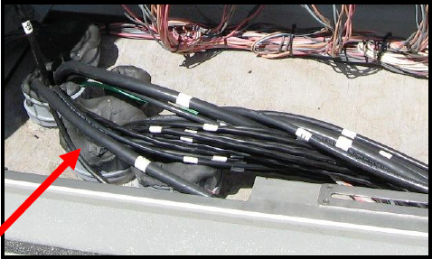
Duct Seal
Add Duct Seal
  Conduits entering the junction box may be protected against water intrusion by inserting duct seal into the conduit and forming it around the wires

Slide 52
Label Wires
Label All Wires
  All of the cables or wires found inside the junction box should be properly labeled

Slide 53
Junction Box Use
Junction Box Use
  Typically used where the direction of the conduit changes
  At points where the conduit enters poles or cabinets
  Where access to the cable is needed for installation purposes
  Excess cable is sometimes stored within a junction box for future use

Slide 54
Junction Box Size and Location
Extra Large Junction boxes
  JB’s come in a variety of sizes (determined during design)
Schematic Nature of Junction box and Conduit Locations
  Some flexibility allowed in location

Slide 55
Junction Box Distance
Distance Between Junction boxes
  Difficult to pull over long distances
  Longer distances used for fiber

Slide 56
Conduit Installation
Conduit Installation
  Trenching
  Boring

Slide 57
Trenching
Trenching
  When trenching is used, the ground or pavement that is disturbed must be restored (as close as possible) to its original condition

Slide 58
Boring
Boring
  Using a boring technique allows all lanes to remain open since the conduit is inserted under the roadway

Slide 59
Depth of Conduit Burial
Depth of Conduit Burial
  Conduit should be buried to the proper underground depth as indicated in Publication 148, TC-8804

Slide 60
Backfilling and Size
Backfilling
  Proper backfilling techniques should be used when filling in the conduit trench
Conduit Size and Type
  The type of conduit to be used and its diameter is identified in the plans or specifications

Slide 61
Size and Spares
Use of Large Diameter PVC Conduits
  In a traffic signal installation, the controller cabinet is the focal point for the various cable runs
Installing Spare Conduits
  If spare conduits are to prove useful in the future, they should be properly installed

Slide 62
Deterioration and Testing Spares
Deterioration of Spare Conduits
  Even when correctly installed and their location properly documented, their continuity tends to deteriorate over the years
Testing Spare Conduits
  If spare conduit is to be used, time should be spent verifying that the conduit run is in usable condition

Slide 63
Wall Strength and Cutting
PVC Conduit Wall Strength
  Two strengths of PVC conduit are routinely encountered in traffic signal work, Schedule 40 and Schedule 80
Cutting PVC Pipe
  PVC conduits often comes in 10’ lengths
  Conduit should be cut with a special tool designed to cut through PVC pipe

Slide 64
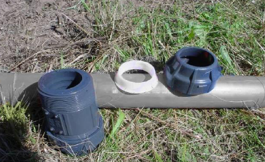
Assembling PVC Conduit
Assembling PVC Conduit
  Lengths of PVC conduit are joined together using PVC couplings and PVC cement

Slide 65
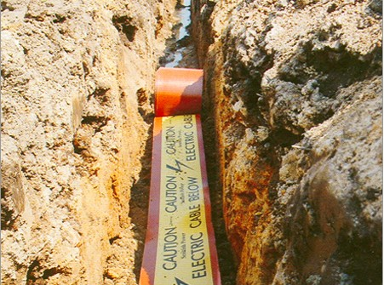
Warning Tape
Underground Warning Tape
  Warning tape 1’ or 2’ above the conduit
Detectable Warning Tape
  Some warning tapes have a metal wire imbedded inside them for locating

Slide 66
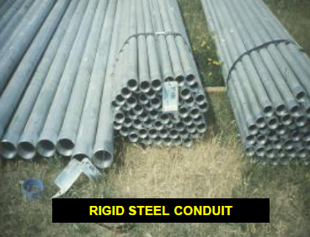
Cutting RGSC
Cutting Rigid Galvanized Steel Conduit (RGSC)
  RGSC conduit also typically comes in 10’ lengths

Slide 67
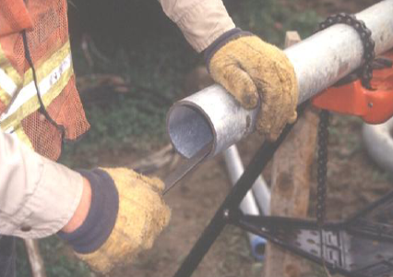
Junction Box and Conduit Installation
De-burring RGSC
  Once the conduit is cut, it must be de-burred to remove the sharp edges using a reaming tool or file

Slide 68
Assembling RGSC
Assembling RGSC
  Lengths of RGSC are joined together using couplings that screw together
  Teflon tape can be applied to the threads of couplings to ensure water tightness

Slide 69
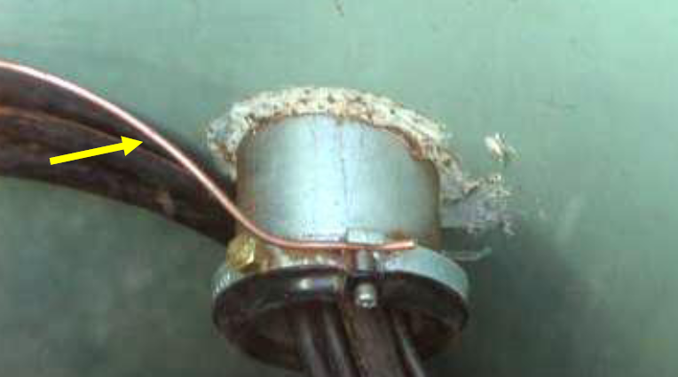
Grounding RGSC
Grounding RGSC
  The terminating ends of RGSC should have a ground bushing that can be used to ground the conduit

Slide 70
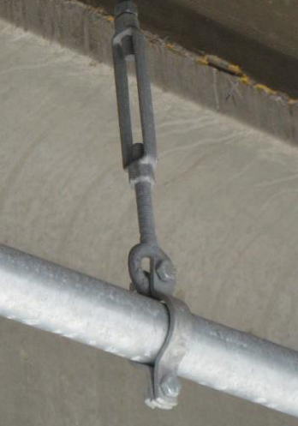
Attaching RGSC
Attaching RGSC
  Conduit straps are used to attach above ground conduit to the structure (bridge, pole, etc.), which carries them.

Slide 71
Controller Cabinet Installation
Manual Section 5.10
Smaller controller cabinets can be mounted directly on the signal support pole
The large cabinets required for most modern, multi-phase intersections are too big for pole mounting and must instead be mounted on a separate ground-installed foundation

Slide 72
Controller Cabinet Foundation
Controller Cabinet Foundation

Slide 73
Cabinet Anchor Bolts
Cabinet Anchor Bolts
  A number of anchor bolts, usually four, are embedded in the concrete
  These bolts are used to attach the cabinet to the foundation
Cabinet Conduits
  All conduits for cabinet installed prior to concrete pouring

Slide 74
Plug Conduits
Plug Conduits
  All conduits entering the cabinet may be plugged to protect against water intrusions, rodent entry, and insect infestations

Slide 75
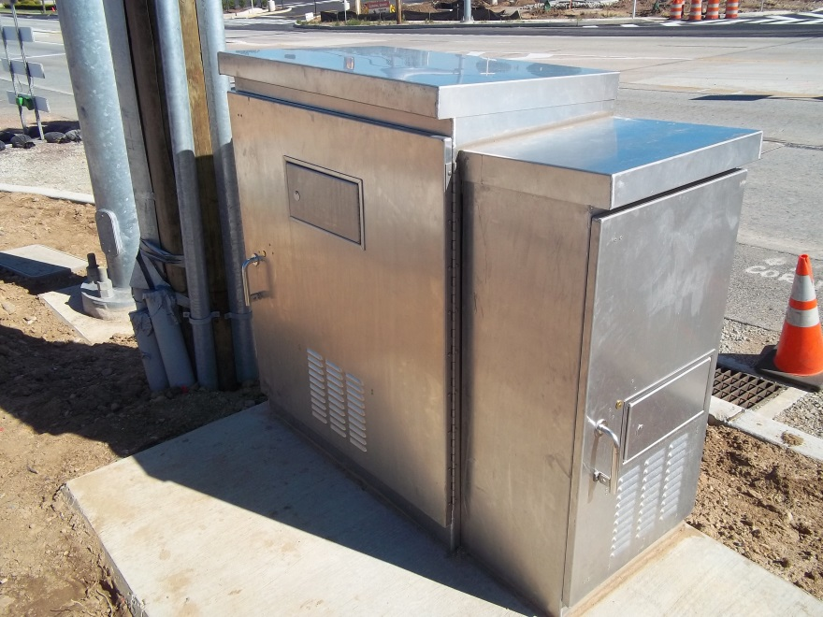
Silicone Seal
Silicone Seal
  Silicone sealant is typically applied between the bottom of the cabinet and the foundation
  Forms a watertight seal between the cabinet and the concrete foundation

Slide 76
Attaching Controller Cabinet
Attaching the Controller Cabinet
  The controller cabinet usually comes completely configured from the factory

Slide 77
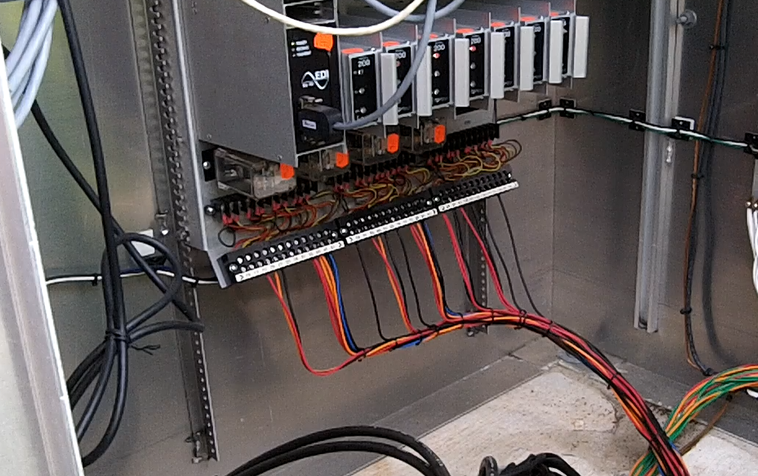
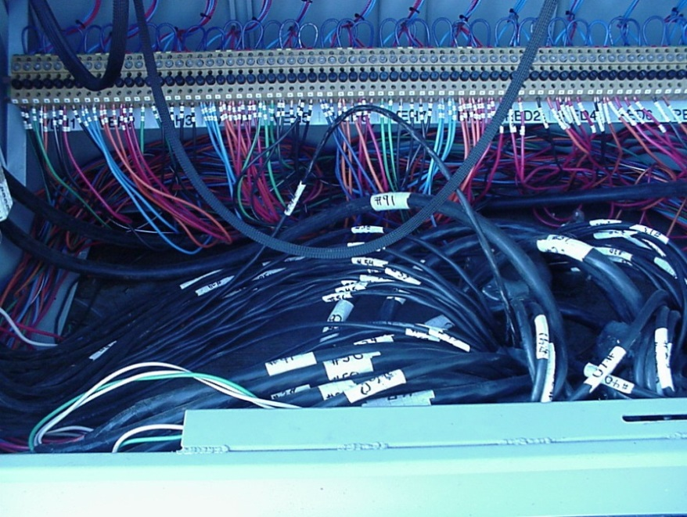
Cabinet Terminal Hook-ups
Cabinet Terminal Hook-ups

Slide 78
Adding Conduits to Existing Cabinets
Adding Conduits to Existing Cabinets
  If no spare conduits are available, the need may arise to add a conduit to an existing controller cabinet
  This can be done in one of two ways:
    Drilling through the concrete foundation on an angle and installing PVC conduit, or
    Drilling a hole in the side of the cabinet and adding a section of RGSC

Slide 79
Strain Pole Wire Installations
Manual Section 5.11
Typically, two wire installations are used for strain poles. Refer to Exhibit 5 18 for a sample of Publication 148, TC-8801

Slide 80
Diameter of Signal Support Wires
Diameter of Signal Support Wires
  The required diameter of the signal wires depends on the loads to be carried, with larger diameter wire being used for heavier loads

Slide 81
Pole Attachment Hardware
Pole Attachment Hardware
  The span wires are used secured to the support pole with attachment hardware that varies by type of pole (wood or steel)

Slide 82
Strandvice
Strandvice
  A strandvice (also called an “automatic compression dead-end clamp”) works like a “Chinese finger” in that it allows the span wire to be pulled through it in only one direction

Slide 83
Chain Hoist
Chain Hoist
  Since the final strain on the span wire will be substantial, a chain hoist (also known as a coffin hoist, a come-along, or a hand winch) must be used to pull the span wire through the strand vice once a load is placed upon it

Slide 84
Tensioning the Span Wires
Tensioning the Span Wires
  Once the span wire hangers and signal heads have been attached to the pole, the chain hoist can be used to tighten the span wires until the appropriate amount of span wire sag is obtained

Slide 85
Release Switch
Release Switch
  If a lessening of the span wire tension is desired, a release switch can be depressed with a flat end screwdriver that allows the span wire to go in the opposite direction through the strand vice

Slide 86
Fiberglass Insulators
Fiberglass Insulators
  When a span wire comes within 6’ of an overhead electric line, some agencies will install a fiberglass insulator in the span to reduce the potential for conductivity between the electric line and the span wire

Slide 87
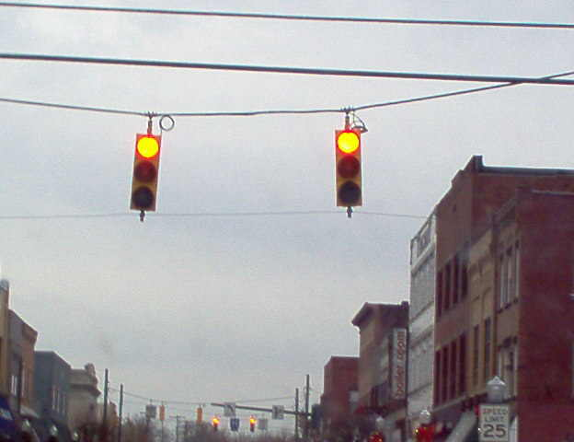
Installing Signal Heads on Span Wires
Installing Signal Heads on Span Wires
  After the span wire has been appropriately tightened, the weighted hangers are replaced with the signal head assemblies

Slide 88
Extension
Extension Hanger
  If two span wires support signal heads, then each head is attached to the wires via an adjustable extension hanger

Slide 89
Installing Signal Heads on Mast Arms
Manual Section 5.12
As with span wires, there is more than one way to attach a signal to a mast arm
These include:
  Free-Swinging Mast Arm Hangers
  Disconnect Hangers
  Rigid Brackets
  Slip-Fitters

Slide 90
Signal Heads on Mast Arms

Slide 91
Free-swinging and Disconnect Hangers
Free-swinging and Disconnect Hangers
  A signal head can be suspended below the mast arm using either a free-swinging hanger or a disconnect hanger

Slide 92
Rigid Attachments
Rigid Attachments
  A signal head can be rigidly attached to the mast arm using either a rigid bracket or a slip-fitter

Slide 93
Slip-fitter
Slip-fitter
  As its name implies, one end of the slip-fitter bracket “slips” over the end of the mast arm, supporting the signal head in either a top mount or side mount configuration

Slide 94
Degree Top Mount Slip Fitter
Degree Top Mount Slip Fitter
  In the top mount configuration, the other end of the slip-fitter bracket attaches to the top of the signal head

Slide 95
Elevator Plumbizer
Elevator Plumbizer
  In the side mount configuration, the other end of the bracket is situated between the signal sections

Slide 96
Rubber Grommet
Rubber Grommet
  A hole must be drilled in the mast arm at every signal head location so that the signal cable can reach the signal head

Slide 97
Signal Cable Installation
Manual Section 5.13
Signal cable must be installed between the controller and each vehicular or pedestrian signal head
Although the number and size of the conductors in a signal cable can vary, from 3 to 16 conductors of size AWG #12 or #14 is typical

Slide 98

Signal Cable Installation Video

Slide 99
Wiring the Heads
Wiring the Heads
  The wires of the signal head harness are connected to the terminal strip

Slide 100
Signal Cable Jacket
Signal Cable Jacket
  The outer jacket of the signal cable should meet IMSA Specification 20 for Polyethylene jacketed signal cable, or 19 for Polyvinyl Chloride jacketed signal cable

Slide 101
Stranded Conductors
Stranded Conductors
  Solid copper conductors are easier to splice and terminate, stranded copper conductors

Slide 102
Required Number of Spares
Required Number of Spares
  Some agencies specify the exact number and size of the conductors to use in each cable
  Other agencies give the contractor some flexibility in making these decisions
  A sufficient number of spare conductors should be provided for:
    Damage to existing
    Future expansion

Slide 103
Terminating Spare Conductors
Terminating Spare Conductors
  At the signal head end, all spare conductors should be terminated, capped, or taped-off
  Exposed wires can shock workers if they somehow become energized

Slide 104
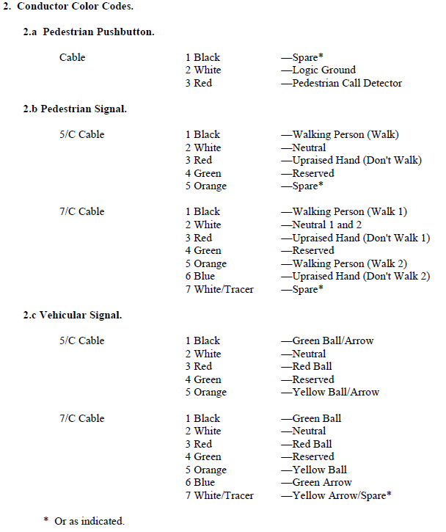
Color Codes
Color Codes
  Most agencies have a standard color-code scheme for the wire to be used in the various signal circuits

Slide 105
Attaching Cables to Span Wire
Attaching Cables to Span Wire
  Signal cable is attached to the messenger wire using several methods
  Pre-formed lashing rods
  Cable rings
  Cable ties (tie wraps)

Slide 106
Pulling Signal Cable
Pulling Signal Cable
  The key in pulling signal cable is to not damage the conductors or scrape-off insulation during installation

Slide 107
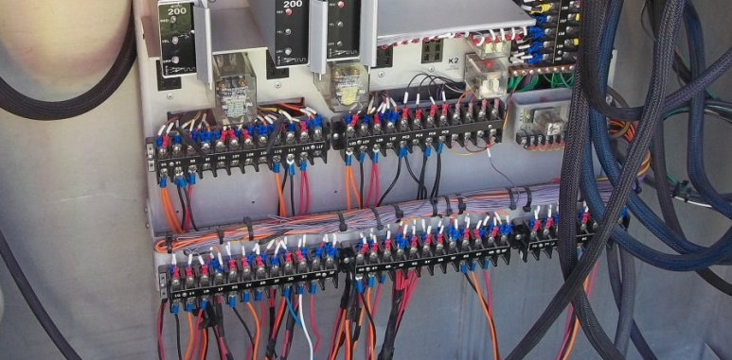
Terminating the Signal Conductors in the Cabinet
Terminating the Signal Conductors in the Cabinet
  Each conductor in the signal cable must be attached to the appropriate field terminal within the controller cabinet

Slide 108
Signal System Grounding
Manual Section 5.14
Making sure that all the metallic components of a traffic signal system are effectively grounded helps protect the following from unanticipated voltage transients, such as those caused by nearby lightning strikes:
  the public
  signal technicians
  electronic equipment

Slide 109
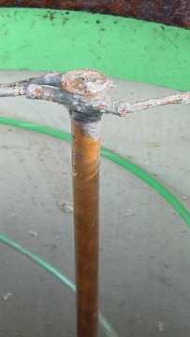
Installing Grounding Electrodes
Installing Grounding Electrodes
  Grounding electrodes are usually about 10’ in length, 5/8” in diameter, and made of steel for strength but clad in copper to increase conductivity and decrease corrosion

Slide 110
Connecting Grounding Electrodes
Connecting Grounding Electrodes
  More than one grounding electrode may be needed to meet the 25 ohms criterion
  The electrodes can be fastened together end-to-end using advanced couplings and driven further into the ground until the required conductivity is obtained

Slide 111
Grounding Electrode Array
Grounding Electrode Array
  An alternative means of meeting the 25-ohm criterion is to drive a series of grounding electrodes to the same depth and then connect them together with copper wire to form an electrode array

Slide 112
Pole-Grounded Effectively
Pole-Grounded Effectively
  To provide a grounding conductor for equipment, the metallic portions of pedestals, mast arms, junction box lids, and strain poles are wired to grounding electrodes that are buried in the earth

Slide 113
Controller-Cabinet Grounded Effectively
Controller-Cabinet Grounded Effectively
  The controller cabinet should also be grounded effectively

Slide 114
Electric Power Service Installation
Manual Section 5.15
Electric power service may be provided by either an overhead or underground connection

Slide 115
Check with Local Electric Company
Check with Local Electric Company
  Many local electric companies have special requirements for electric power service installations
  Some require a permit and associated connection fee while some do not

Slide 116
Overhead Power Service Connection
Overhead Power Service Connection
  The service cable from the power source enters a weatherhead
  Travels down the pole inside Rigid Galvanized Steel Conduit (RGSC) to a meter base (if one is required)
  Then on to a disconnect breaker that provides over-current protection

Slide 117
Underground Power Service Connection
Underground Power Service Connection
  The service cable from the power company arrives at the service pole in an underground conduit
  Travels up the service pole in RGSC to the line side of the meter base and disconnect

Slide 118
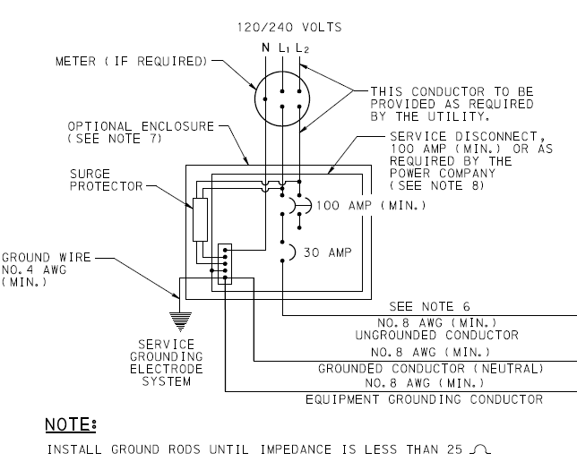
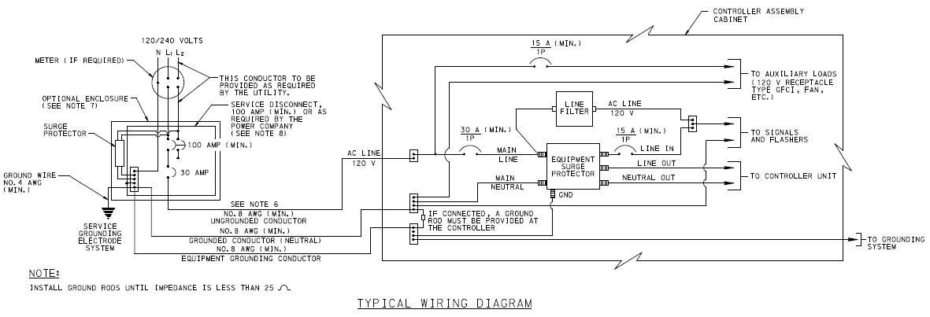

Size of the Circuit Breaker
Size of the Service Wire
  The NEC requires that the minimum service wire be AWG #8 or larger
Size of the Circuit Breaker
  The circuit breaker for the electrical disconnect should be rated above that of the circuit breakers located within the cabinet so that the cabinet circuit breakers trip first

Slide 119
Grounding the Power Service
Grounding the Power Service
  The electric power service assembly, including the disconnect, meter base, and associated RGSC, must be connected to the grounding system of the pole on which the power service assembly is attached

Slide 120
Inductance Loop Installation
Manual Section 5.16
Inductance Loop Installation
  Many types of vehicle detection systems exist
    Video
    Magnetometers
    Microwave
    Infrared
    etc.
  inductance loops are the most common

Slide 121
Install the Correct Type of Loop
Install the Correct Type of Loop

Slide 122
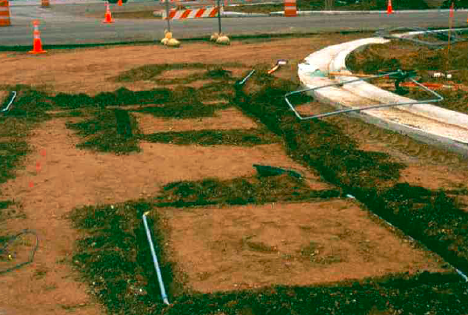
Under Pavement Loops
Under Pavement Loops
  The plans sometime call for the inductance loops to be installed before the final surface course is place

Slide 123
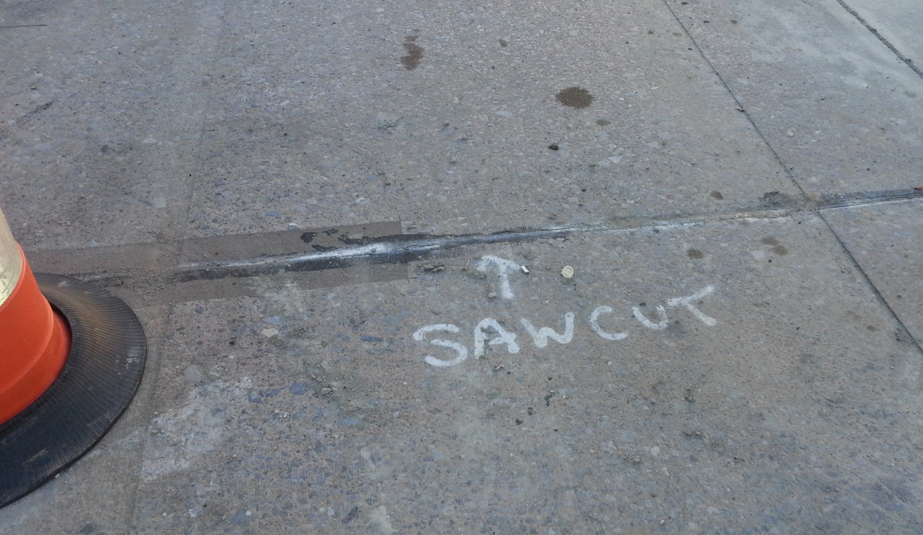
Marking the Loops
Marking the Loops
  An outline of the loops should be made on the pavement with chalk or spray paint prior to cutting the loops

Slide 124
Saw-cut Depth
Saw-cut Depth
  The depth of the saw-cut depends on the number of turns of wire and the diameter of the wire

Slide 125
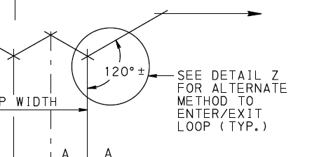
Protecting Against Insulation Damage
Protecting Against Insulation Damage
  Sharp corners might damage the loop wire insulation
    typically eliminated by either installing an angled saw-cut at the corners of the loop or by installing rounded corners

Slide 126
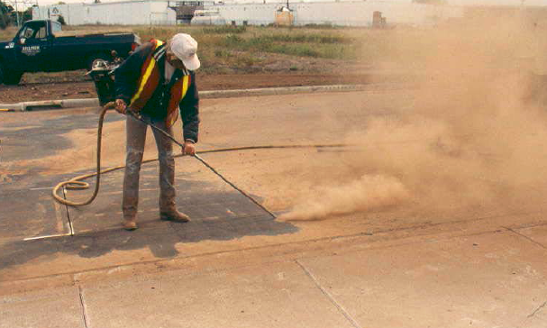
Cleaning Out the Saw-cuts
Cleaning Out the Saw-cuts
  Saw-cuts must be cleaned of all loose debris using either a blower or a strong vacuum

Slide 127
Wire Size and Type
Wire Size
  Inductance loops are typically constructed using AWG #14 or AWG #12 wire rated for 600 volts
Wire Type
  Should meet specifications

Slide 128
Number of Turns
Use the Correct Number of Turns
  Either the plans or specifications will indicate the number of “turns” of loop wire that must be installed in the saw-cut

Slide 129
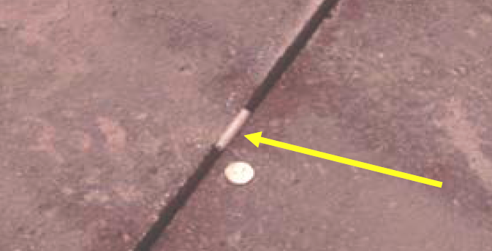
Backer Rod
Backer Rod
  short strips of non-metallic hold-down material (such as polyethylene foam) are wedged into the saw-cut at 1’ intervals

Slide 130
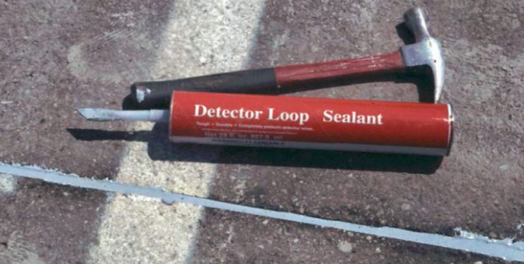
Sharp Objects and Sealants
Avoid Sharp Objects
  sharp objects that could damage the loop wire
Use of Proper Loop Sealants
  Loop sealants are specially formulated to encapsulate the loop wires

Slide 131
Use of Shielded Lead-in Cables
Use of Shielded Lead-in Cables
  loop wire should be spliced to a shielded lead-in cable at a junction box before it is run to the cabinet

Slide 132
Importance of Good Splice
Importance of Good Splice
  The splice between the loop wire and the shielded lead-in cable is a potential weak point in the loop circuit and must be carefully constructed

Slide 133
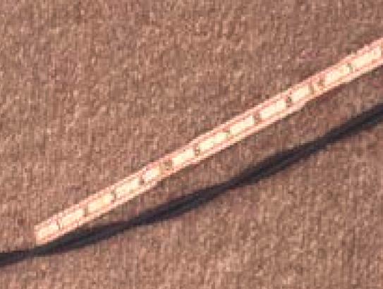
Twisting the Tail
Twisting the Tail
  The unshielded loop wire located in the tail should be twisted at a rate of no less than five twists per 1’

Slide 134
Shielded Lead-in Cable
Shielded Lead-in Cable
  Typically constructed of AWG #14 or AWG #12 wire
  Twisted at approximately 15 twists per 1’
  covered by an aluminum-polyester shield and encased in a continuous polyethylene outer jacket

Slide 135
Loop Terminology
Loop Terminology
  The portion of the loop assembly located between the loop itself (the tail) and the shielded lead-in cable is called
  “home run” or
  BELDEN (Mfg. of lead-in cable)

Slide 136
Loop Termination Panel
Loop Termination Panel
  The loop field wires are connected to a loop termination panel located inside the controller cabinet

Slide 137
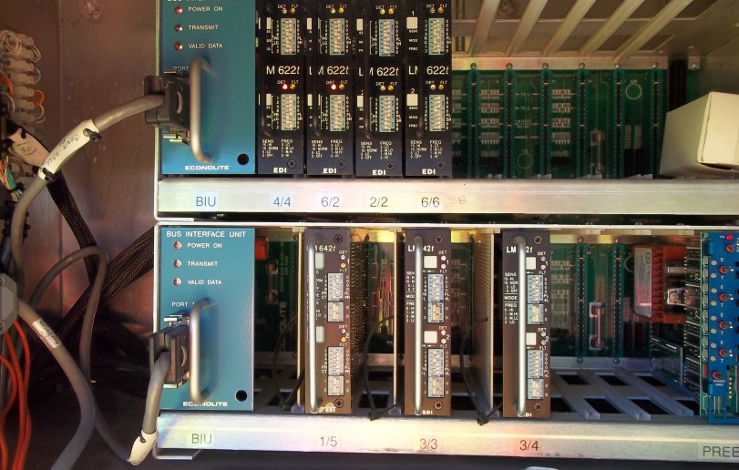
Detector Unit
Detector Unit
  Senses the change in inductance caused by a vehicle passing over the loop and converts this information into an electrical signal that the traffic signal controller can recognize

Slide 138
Loop Crosstalk
Loop Crosstalk occurs between loops when the loops are:
  Located close together
  Similar size
  Operating on a similar frequency
Preventing Loop Crosstalk
  Can be prevented by setting detectors that control adjacent loops to different frequencies

Slide 139
Work Zone Protection During Loop Installation
Work Zone Protection During Loop Installation
  Installation should not be attempted without proper work zone traffic control
  Appropriate advance signing will be needed
  Depending on the situation may need
    flashing arrow board
    police officer
    properly trained flaggers

Slide 140
Final Clean Up
Manual Section 5.17
When construction of the signal is complete, the area should be
  returned to a condition that is similar to the condition that existed before construction began
  Any damage caused by the construction activities should be repaired and the area cleared of all construction-related debris

Slide 141
As-Built (Record) Plans
Manual Section 5.18
Once the signal installation has been accepted, as-built (record) drawings need to be made and sent in with the semi-final records
Any part of the installation of the traffic signal that differs from the original design needs to be noted so that others have accurate information as to how it was built

Slide 142




Chapter 5 Quiz

Slide 143
Module 5 Completion
You have now completed Module 5, Traffic Signal Construction
To review any section in this module, use the “Outline” on the left
Up next is Module 6, Traffic Signal Inspection
Module 6 is the final module in the course

Slide 144
Remaining Modules
The remaining module is:
  Module 6: Traffic Signal Inspection
Return to the PennDOT Technical Training Calendar to select Module 6

