Slide 1

Exam Instructions (1 of 2)
For each multiple-choice question, select the best response.
Please choose only one answer for each question.
You may use your training materials, notes, etc. to assist you in answering the questions.
Each question is worth 1 point for a total point value of 20.
Notes:
To receive credit for the course, you must first complete an exam.
For each multiple-choice question, select the best response by clicking on it in the exam.
Please choose only one answer for each question. Once you have selected yoru answer, choose the “Submit” button. However, note, once you have selected the submit button you are not longer able to go back and change the answer you have selected.
You may use your training materials, notes, etc. to assist you in answering the questions.
Each question is worth 1 point for a total point value of 20.

Slide 2
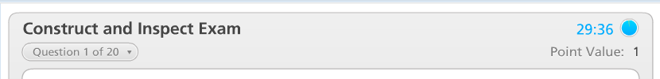
Exam Instructions (2 of 2)
You need 70% (14 correct) to pass.
You will have 30 minutes to complete this exam.
When finished, please Print the exam results and submit to PennDOT.
Click here to begin exam

Slide 3
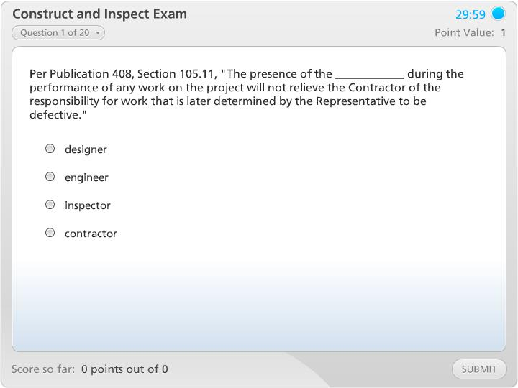
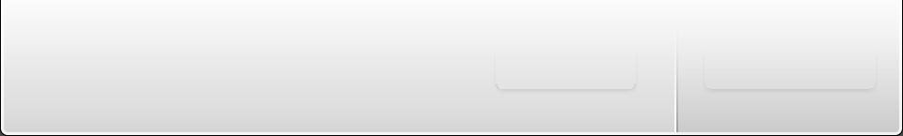


Construct and Inspect Exam

